Slide 1
For Live Session Assignment (FLS)
Unit 12

Slide 2
Quick Quiz Questions

Slide 3
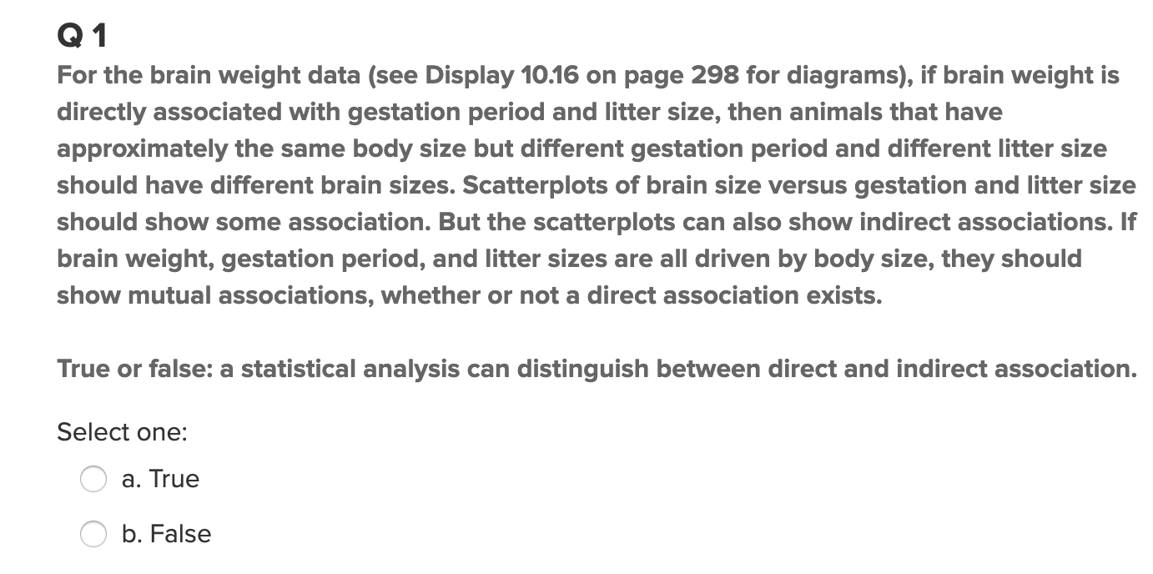
Quick Quiz Questions

Slide 4
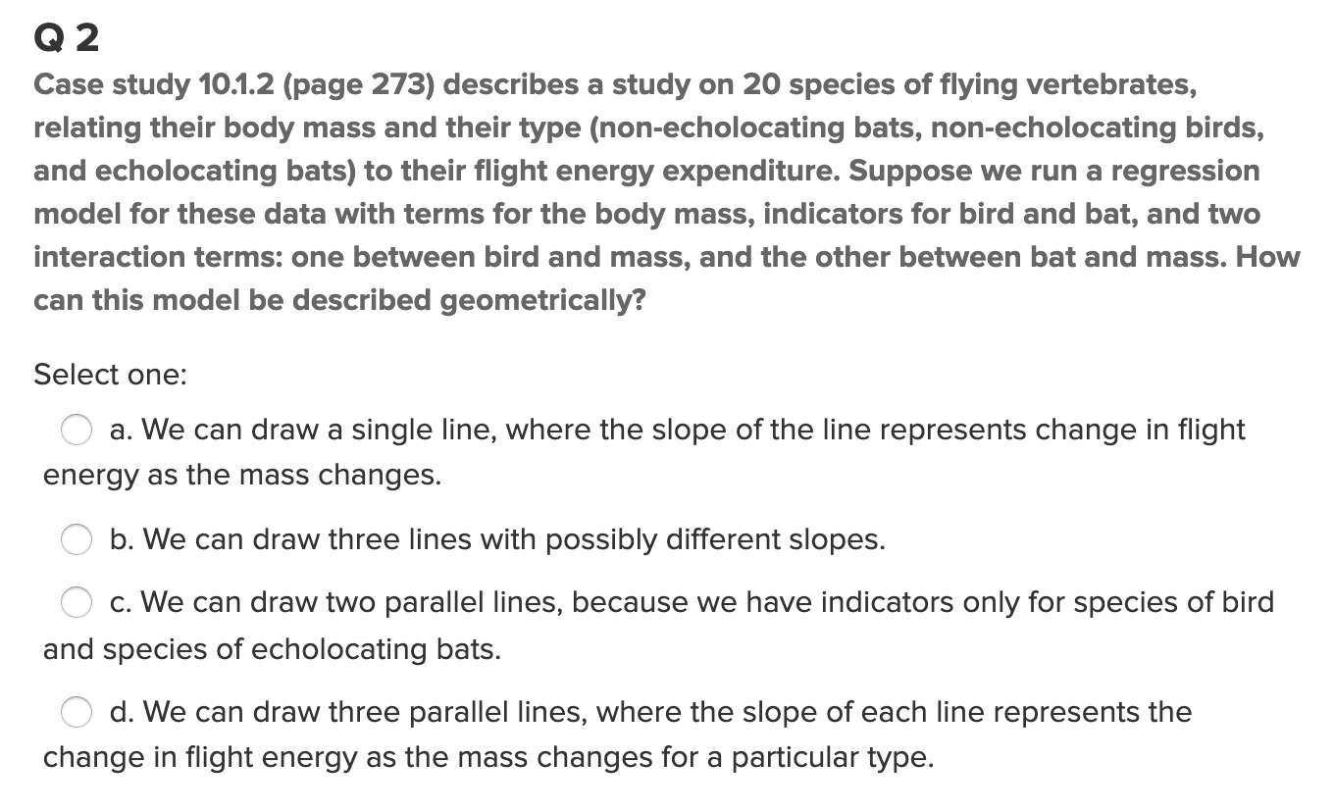
Quick Quiz Questions

Slide 5
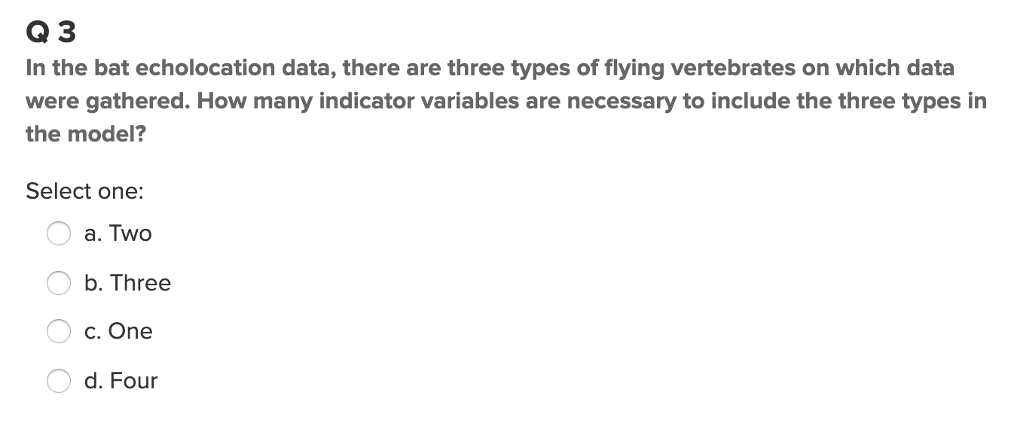
Quick Quiz Questions

Slide 6
End Quick Quiz Questions

Slide 7
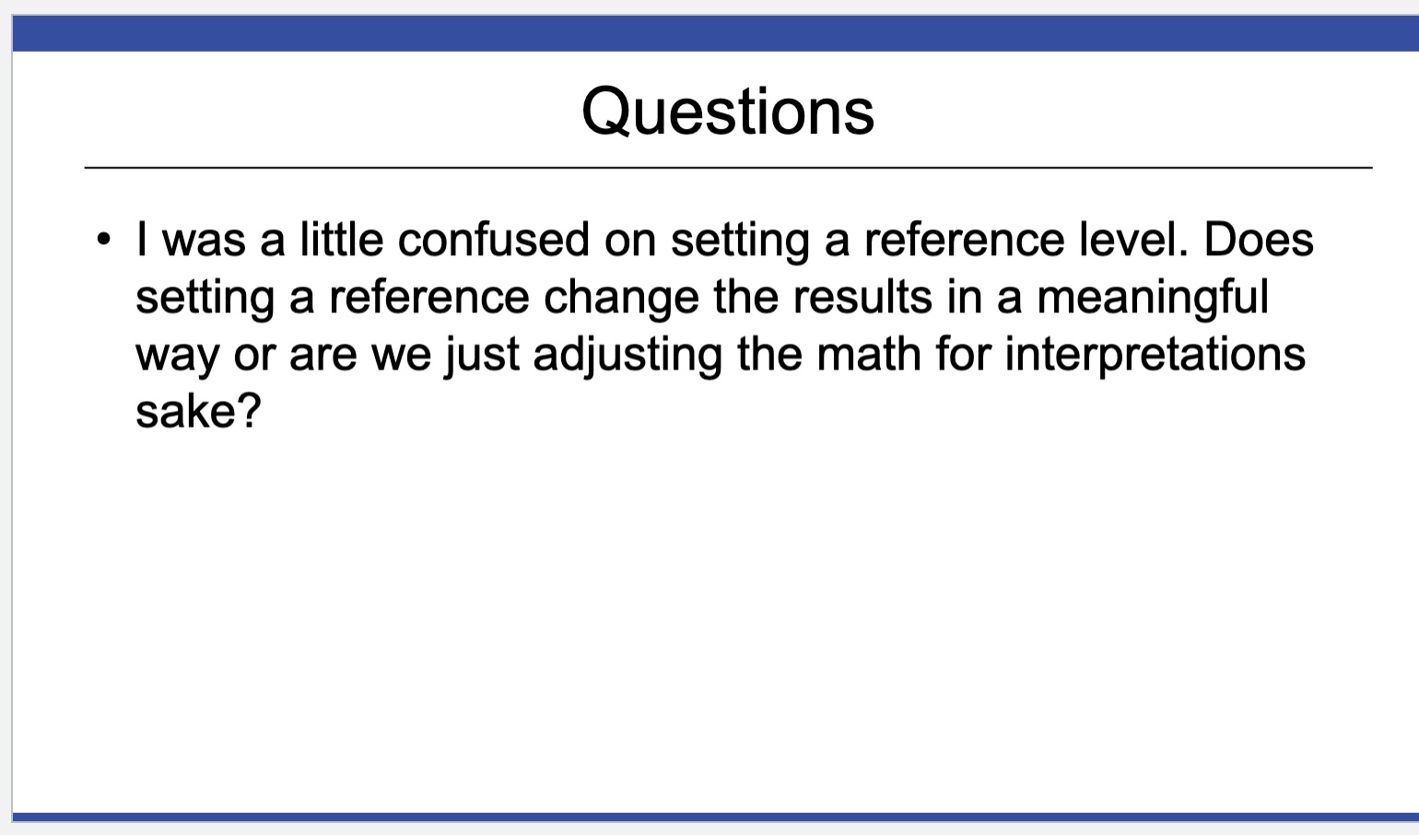
Question from FLS

Slide 8
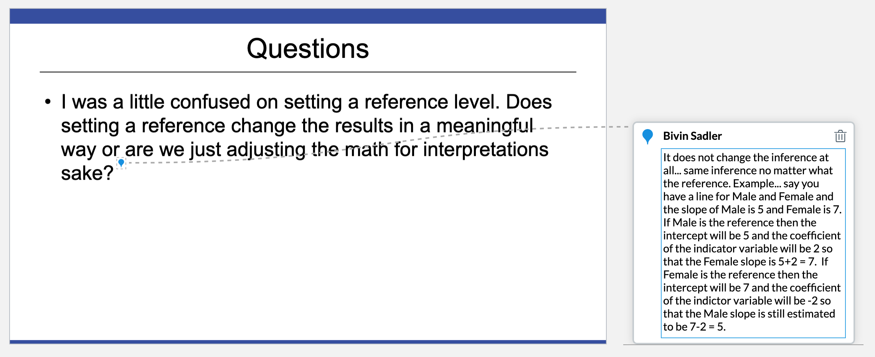
Question from FLS

Slide 9
Question 1

Slide 10
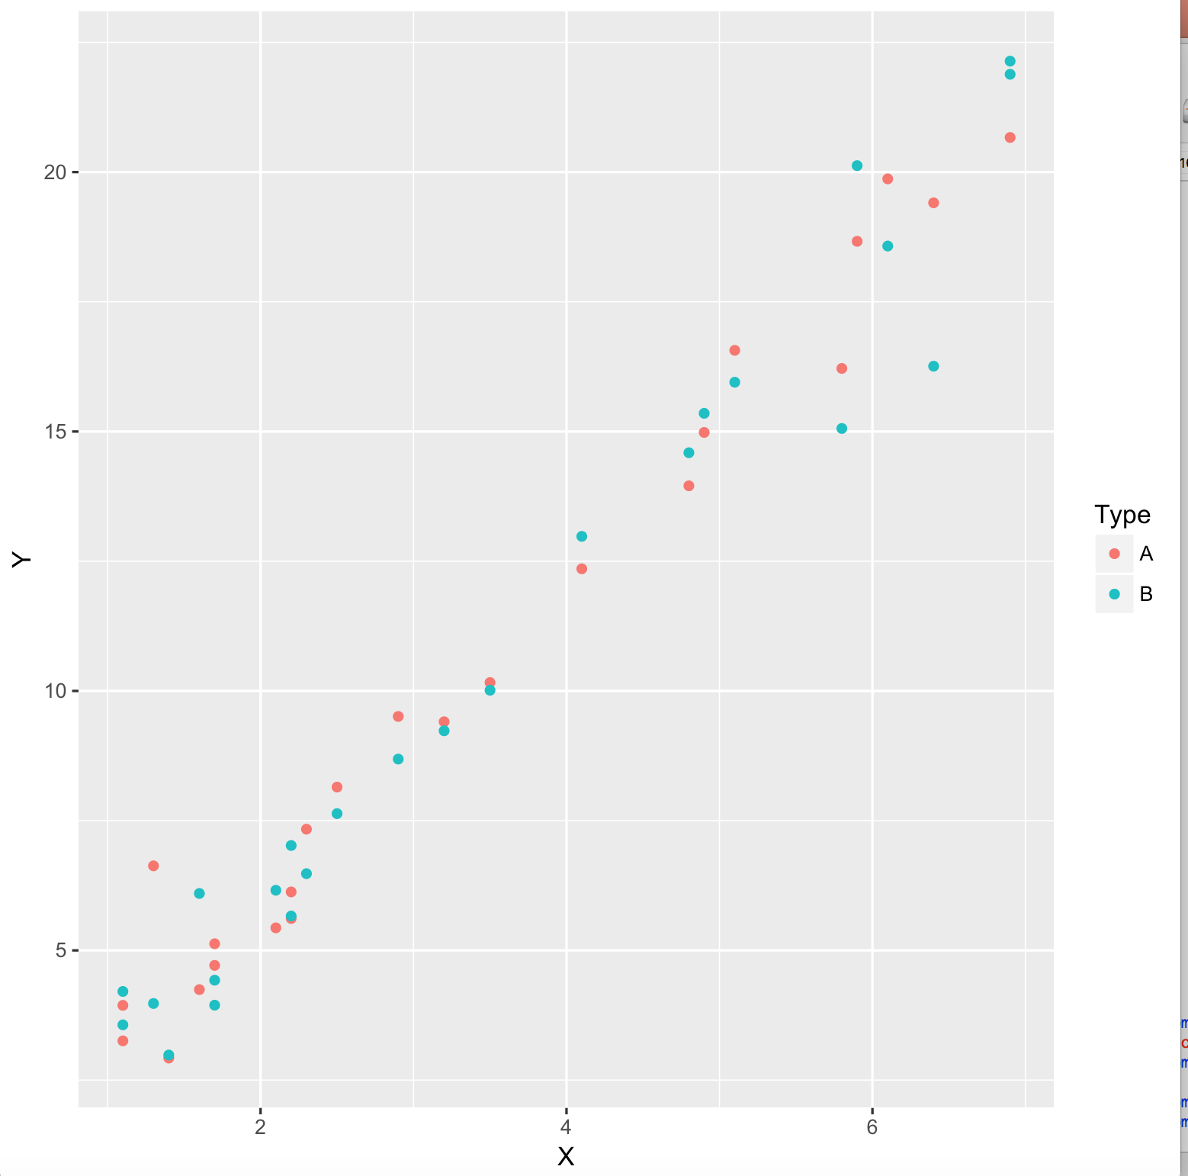
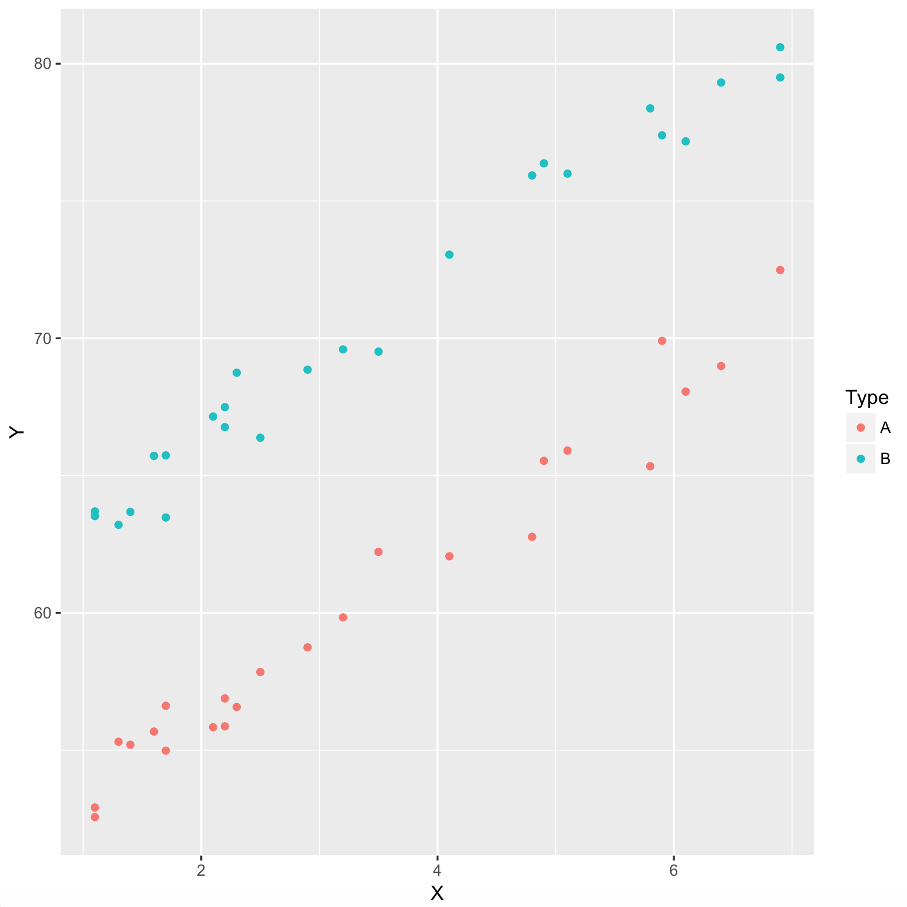
A Comparison of Y-Intercepts

Slide 11
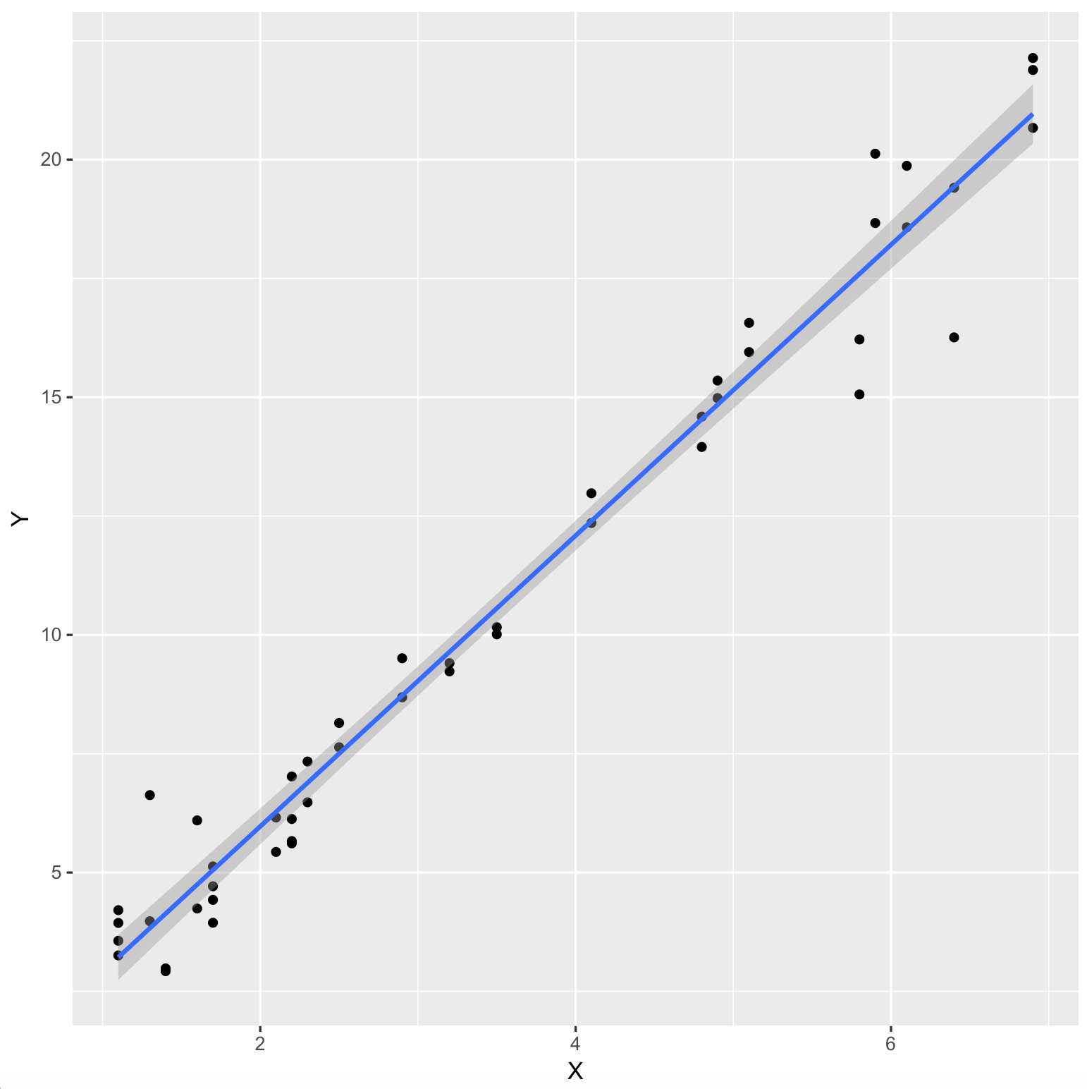
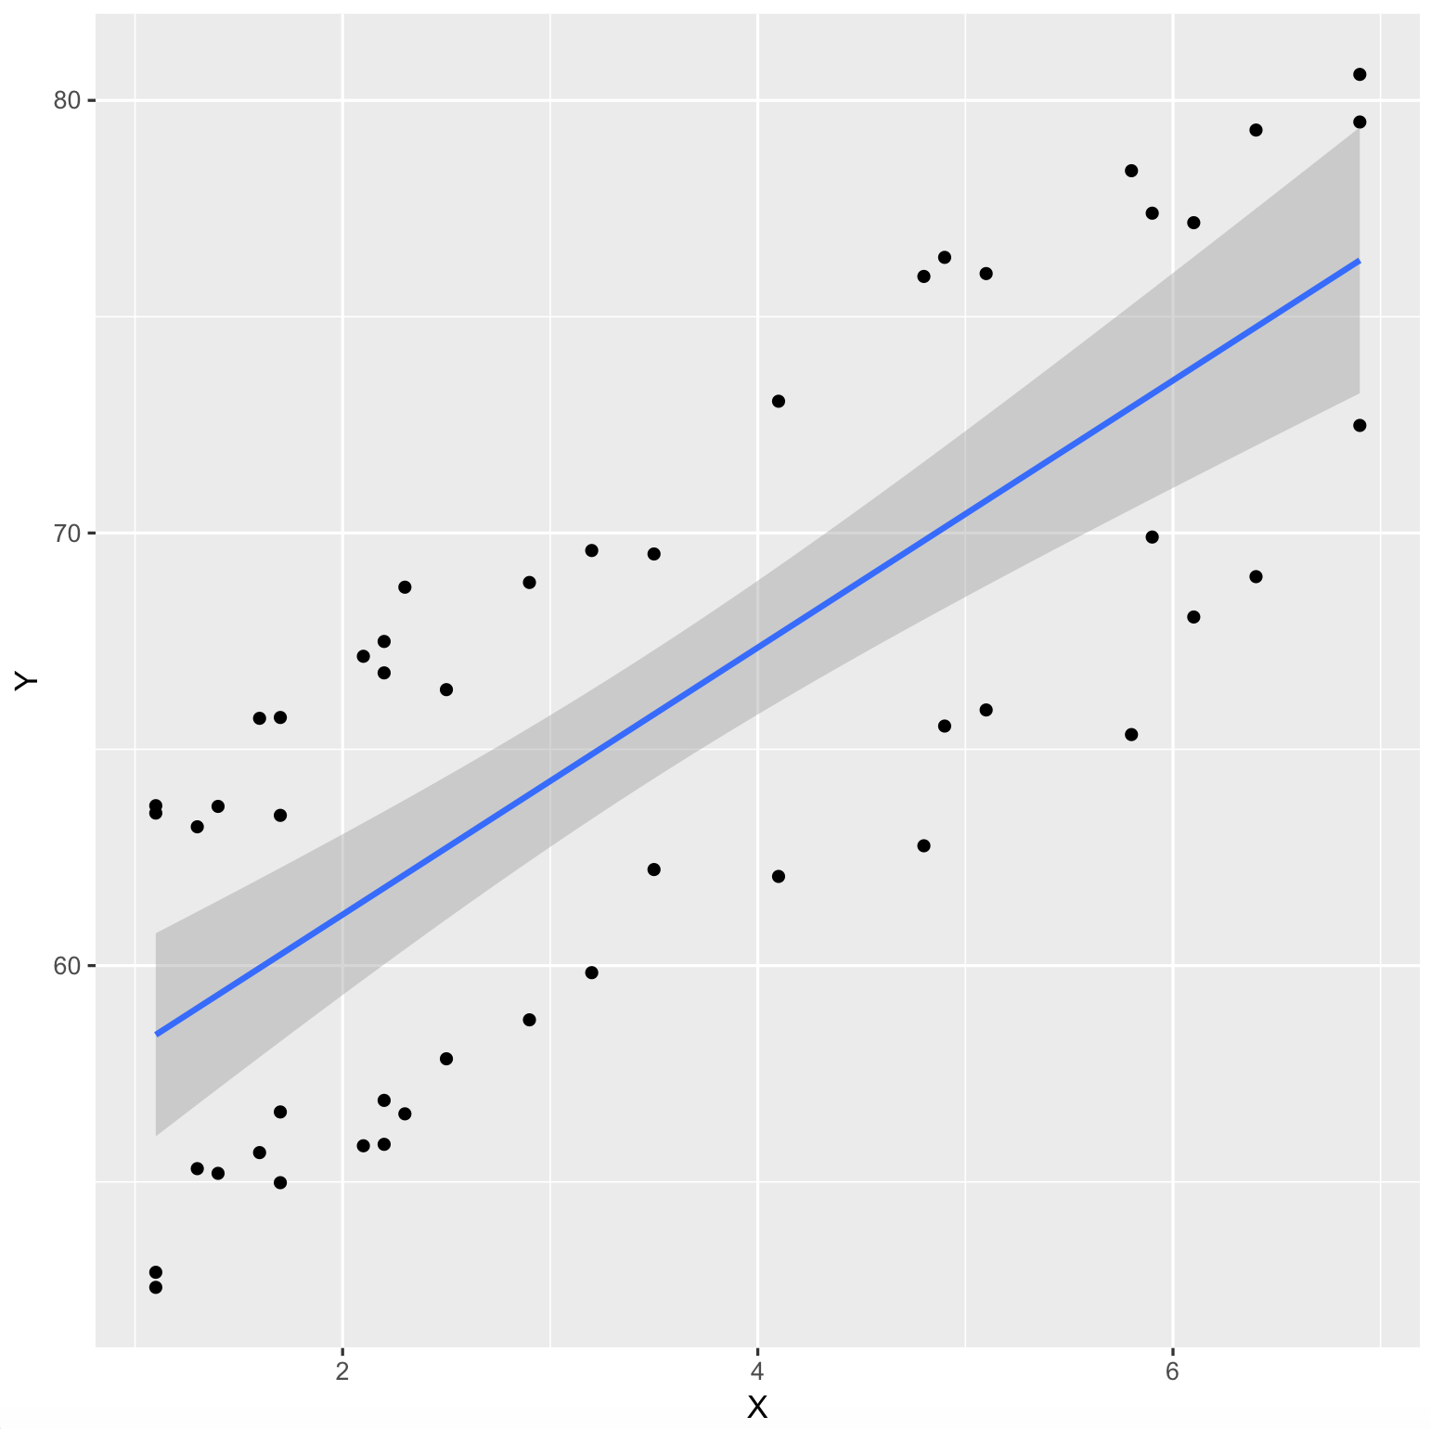
A Comparison of Y-Intercepts (Type Doesn’t Matter)

Slide 12
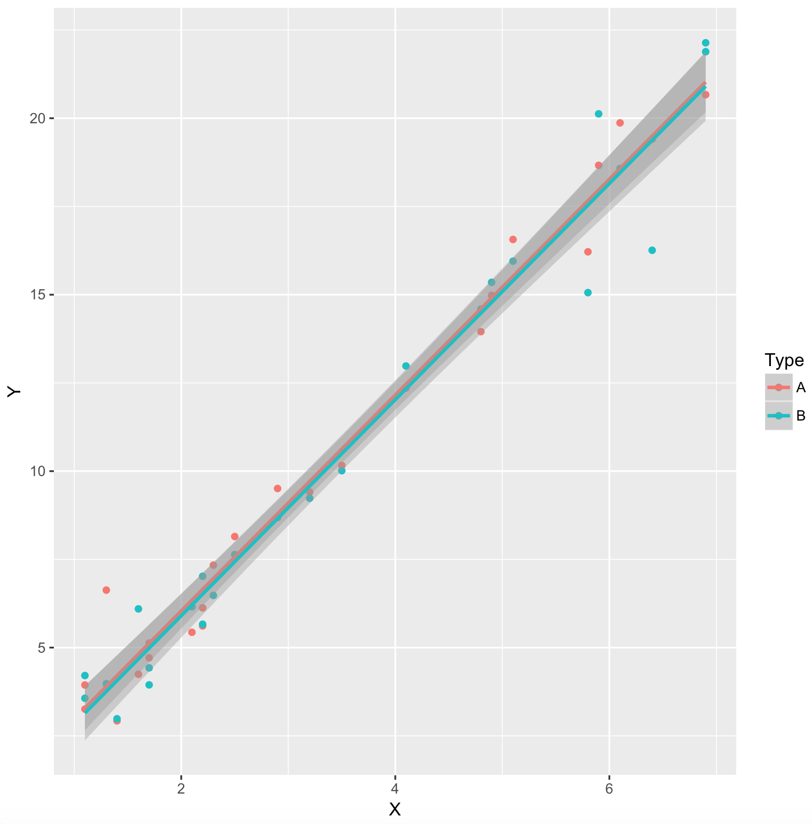
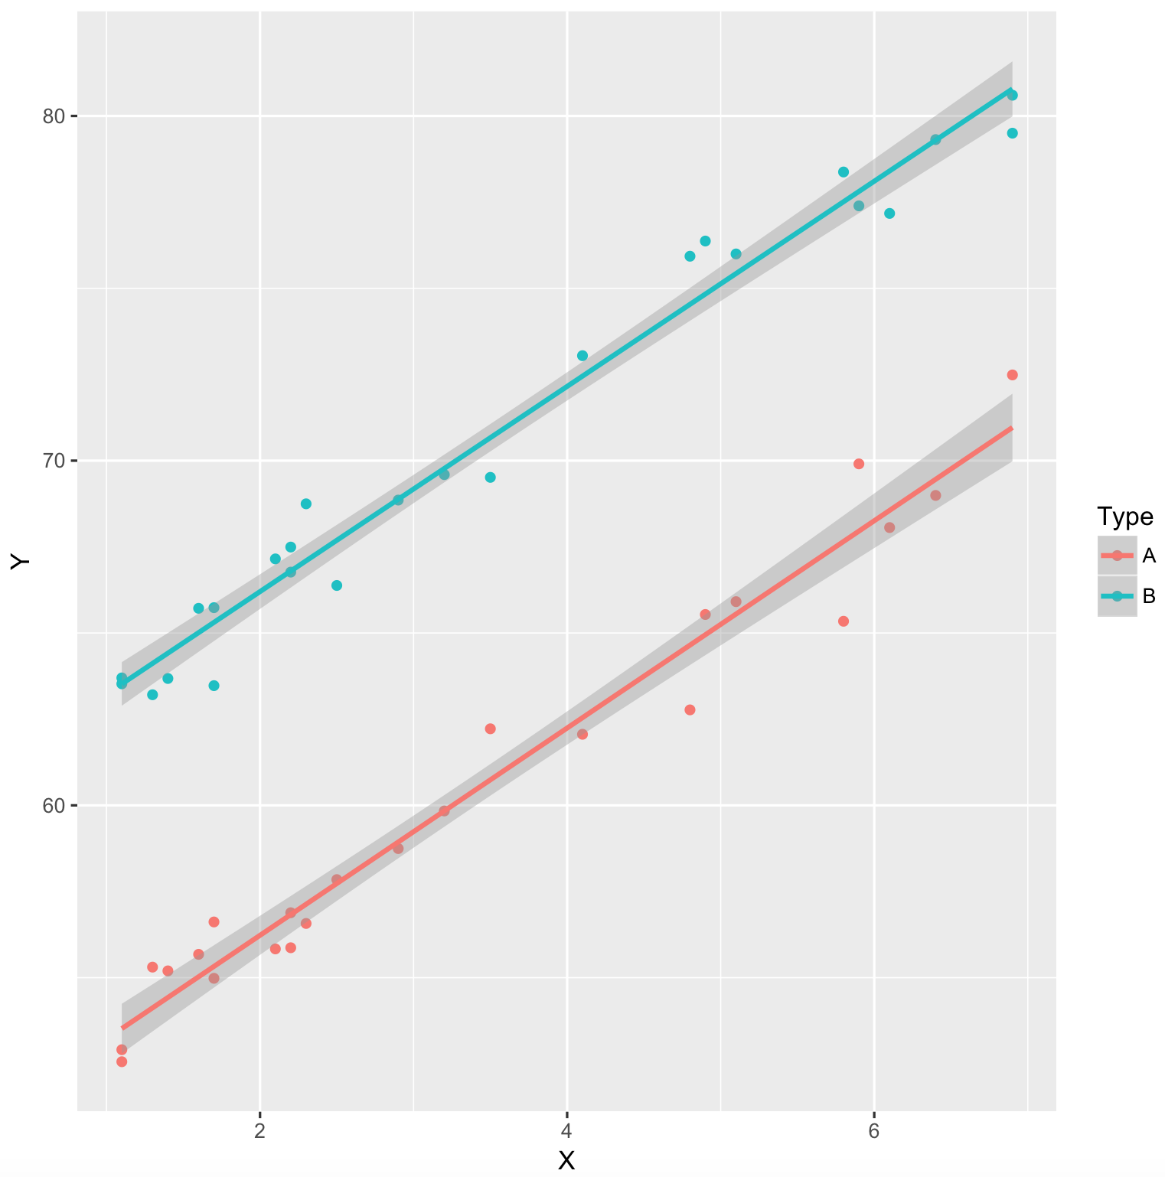
A Comparison of Y-Intercepts

Slide 13
R GGPLOT2
Dataset
X and Y
This actually adds the points to the plot.
This fits and plots the regression line.

Slide 14
R GGPLOT2
Dataset
X and Y
This identifies the two groups to plot a fit.
This actually adds the points to the plot.
This fits and plots the regression line.

Slide 15
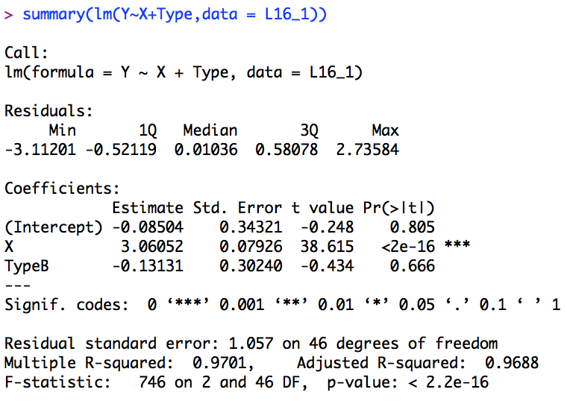
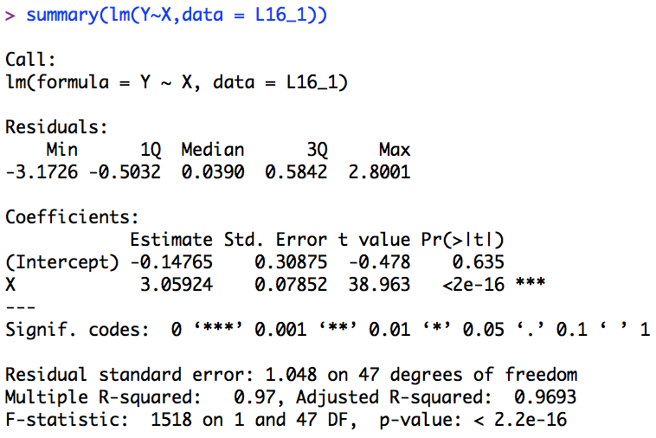
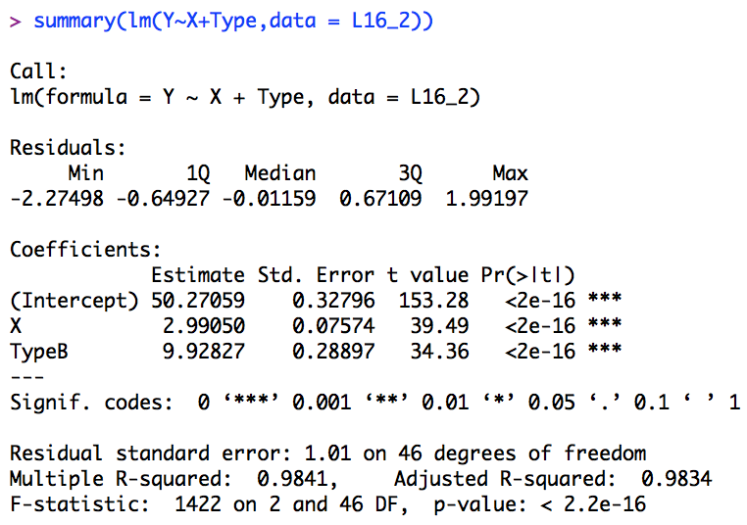
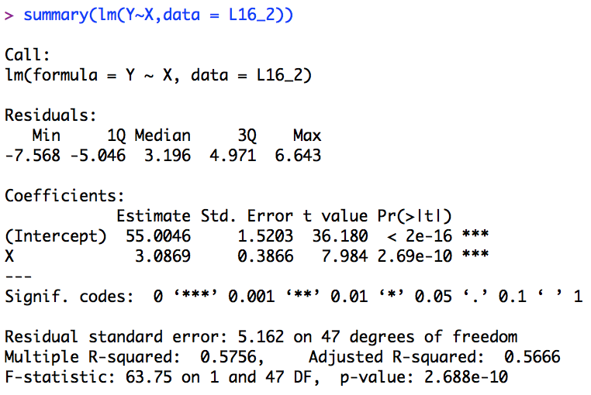
But back to the question! A Comparison of Y-Intercepts

Slide 16
Hypothesis Test of the Categorical Variable
This is an estimate of the Type A intercept.
This is an estimate of the DIFFERENCE between the Type A and Type B Intercepts.
The difference in intercepts is NOT significantly different from 0. (p-value = .666)

Slide 17
Hypothesis Test of the Categorical Variable
{
{
9.93
This is an estimate of the Type A intercept.
9.93
Since the lines are parallel.
This is an estimate of the DIFFERENCE between the Type A and Type B Intercepts.
Type B’s Intercept is estimated to be 9.93 units bigger than Type A’s intercept.
Type B’s Estimated Intercept = 50.27 + 9.93 = 60.20 units

Slide 18

Hypothesis Test of the Categorical Variable
$$Type A: \hat{Y}=50.27+2.99X$$
$$Type B: \hat{Y}=\left(50.27+9.93\right)+2.99X=60.20+2.99X$$

Slide 19




Categorical Variables in MLR … Different Intercepts!
$$Model: μ\text{\{}Y | \text{X}\text{, }\text{Type}\text{ \} =}{ β}_{0}+β_{1}X+β_{2}Type$$
Type = 0 for A
$$μ\text{\{}Y | \text{X}\text{, }\text{Type}\text{ = 0\} =}{ β}_{0}+β_{1}X$$
Type = 1 for B
$$μ\text{\{}Y | \text{X}\text{, }\text{Type}\text{ = 0\} = }{(β}_{0})+β_{1}X$$
This makes ’A’ the “Reference.”
$$μ\text{\{}Y | \text{X}\text{, }\text{Type}\text{ = 1\} = }β_{0}+β_{1}X+β_{2}$$
$$μ\text{\{}Y | \text{X}\text{, }\text{Type}\text{ = 1\} = }{(β}_{0}+β_{2})+β_{1}X$$
Note 1: $β_{2}$ is the adjustment to Type A’s intercept to get Type B’s Intercept.
Note 2: $β_{1}$ is the slope for both lines. They are parallel.

Slide 20




Categorical Variables in MLR … Different Slopes! Think INTERACTION
$Model: μ\text{\{}Y | \text{X}\text{, }\text{Type}\text{ = 0\} =}{ β}_{0}+β_{1}X+β_{2}Type$ $+β_{3}Type∗X$
$$μ\text{\{}Y | \text{X}\text{, }\text{Type}\text{ = 0\} =}{ β}_{0}+β_{1}X$$
Type = 0 for A
$$μ\text{\{}Y | \text{X}\text{, }\text{Type}\text{ = 0\} = }{(β}_{0})+β_{1}X$$
Type = 1 for B
$$μ\text{\{}Y | \text{X}\text{, }\text{Type}\text{ = 1\} = }β_{0}+β_{1}X+β_{2}+β_{3}X$$
This makes ’A’ the “Reference.”
$$μ\text{\{}Y \left| \text{X}\text{, }\text{Type}\text{ = 1\} = }{(β}_{0}+β_{2}\right)+β_{1}X+β_{3}X$$
$$μ\text{\{}Y \left| \text{X}\text{, }\text{Type}\text{ = 1\} = }{(β}_{0}+β_{2}\right)+{(β}_{1}+β_{3})X$$
Note 1: $β_{2}$ is the adjustment to Type A’s intercept to get Type B’s Intercept.
Note 2: $β_{3}$ is the adjustment to Type A’s slope to get Type B’s Slope!
They are not forced to be parallel!

Slide 21
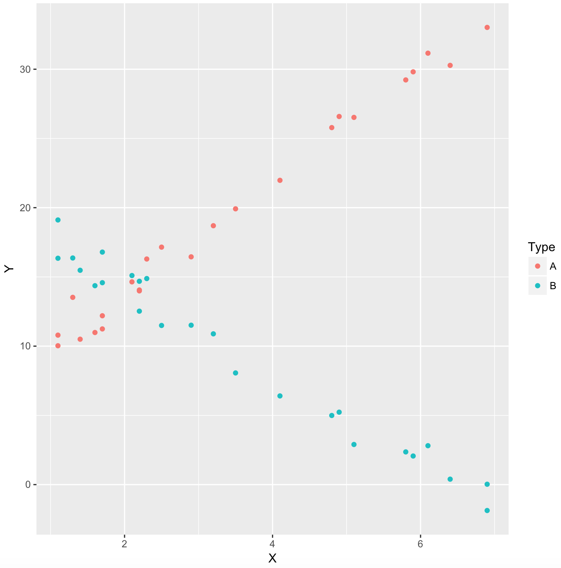
A Comparison of Slopes!
There is clear visual evidence of different slopes and different y-intercepts. Let’s fit a model that allows the flexibility to reflect this.

Slide 22
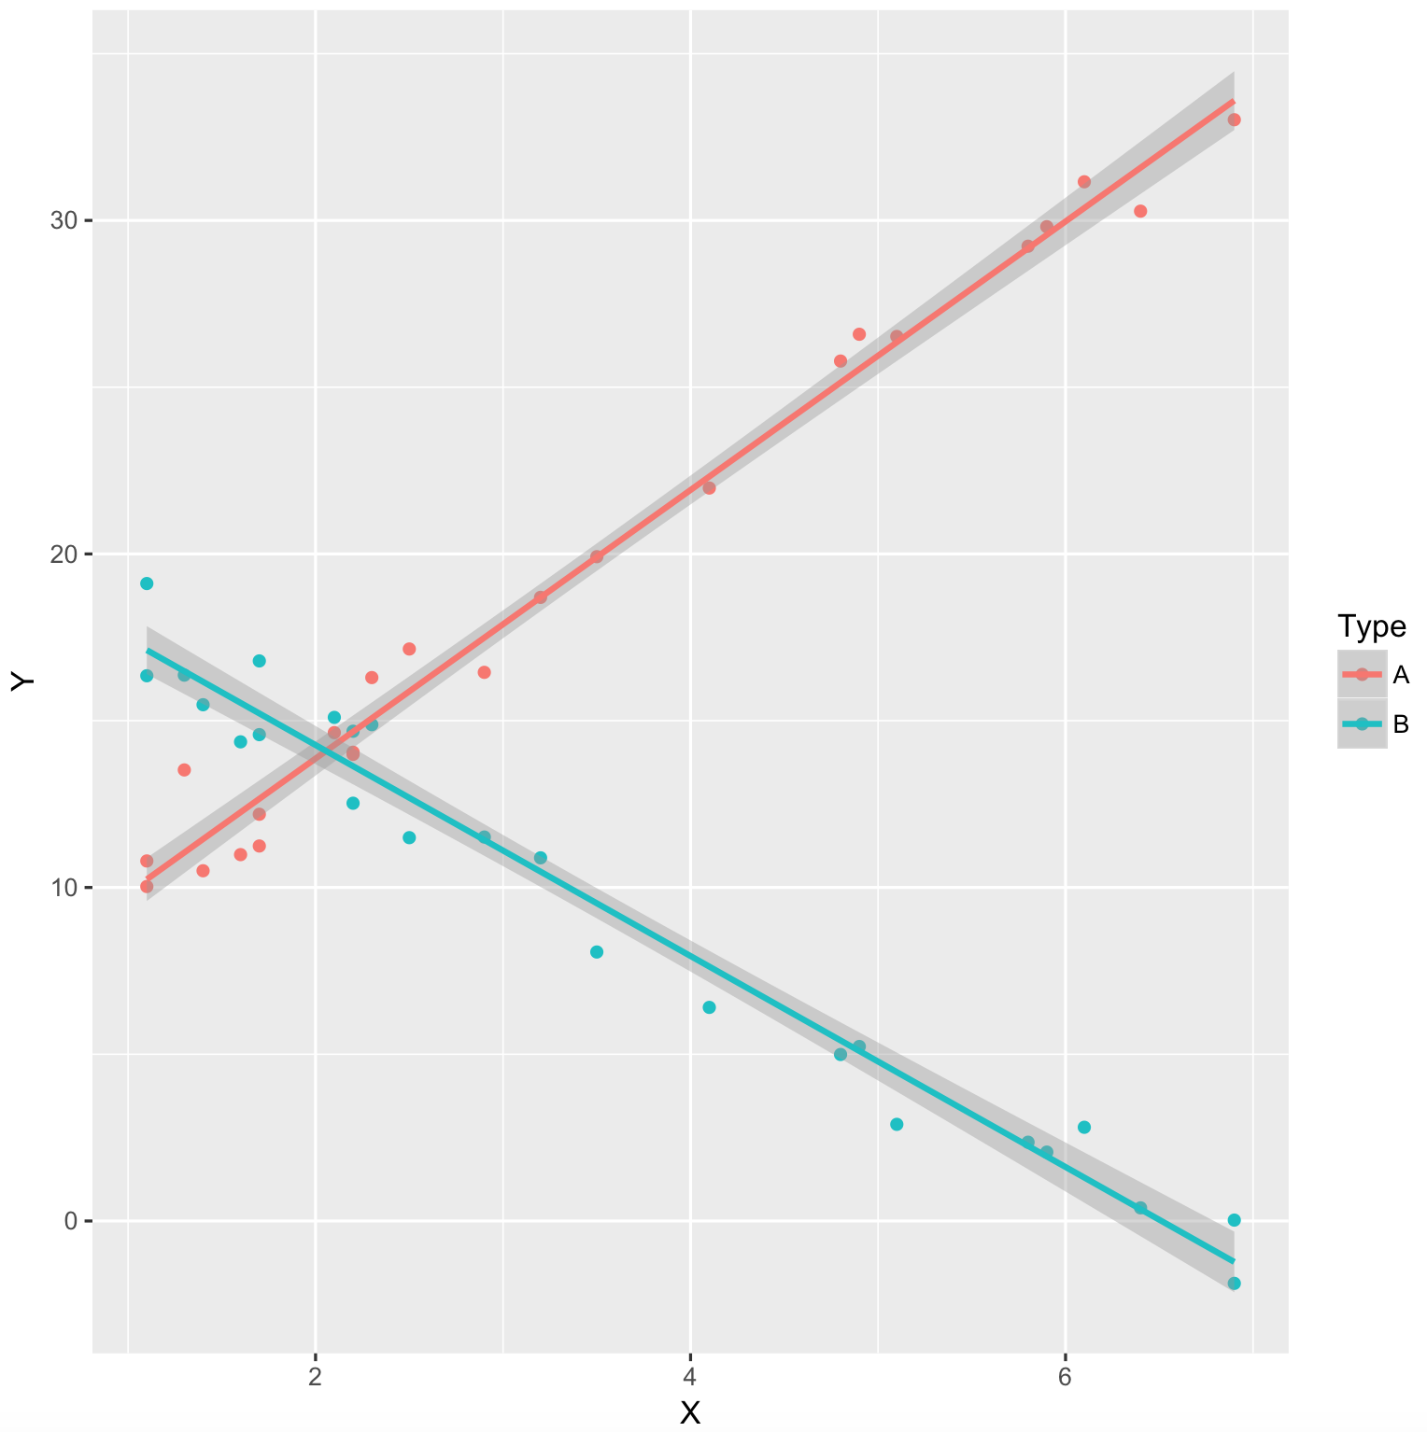
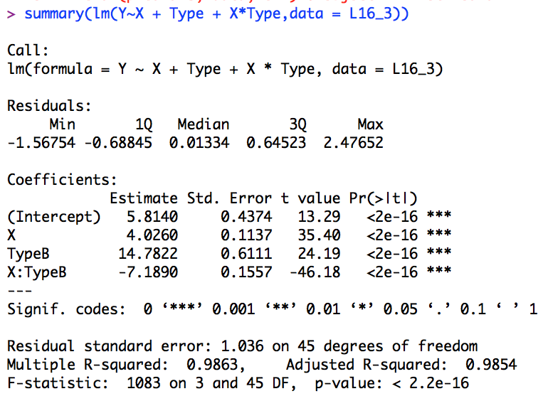


A Comparison of Slopes!
$$Type A: \hat{Y}=5.8140+4.03X$$
$$Type B: \hat{Y}=(5.81+14.78)+(4.03+(−7.19))X$$
$$Type B: \hat{Y}=20.59−3.16X$$

Slide 23
What do we think about these from before? Different Slopes?

Slide 24
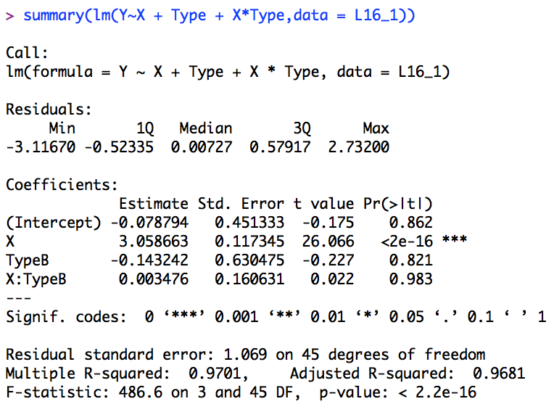
What do we think about these from before? Different Slopes?

Slide 25
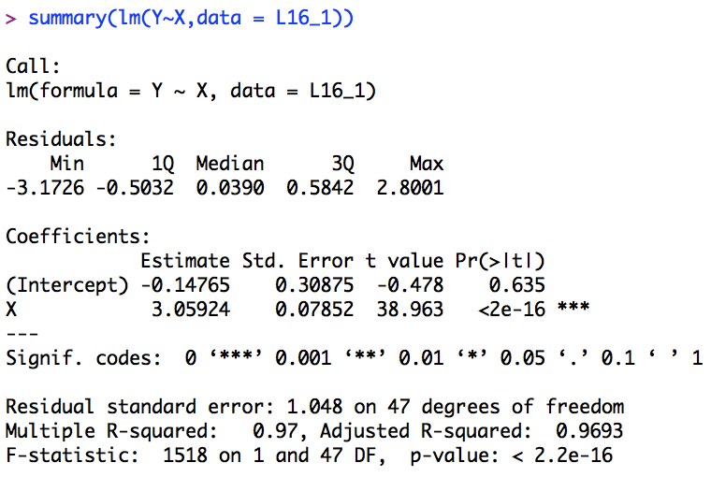


What do we think about these from before? Different Slopes?
$$Type A: \hat{Y}=−.18+3.06X$$
$$Type B: \hat{Y}=−.18+3.06X$$

Slide 26
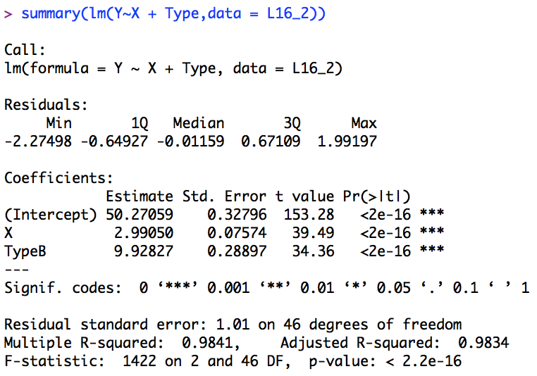

What do we think about these from before? Different Slopes?
$$Type A: \hat{Y}=50.27+2.99X$$
$$Type B: \hat{Y}=\left(50.27+9.93\right)+2.99X=60.20+2.99X$$

Slide 27
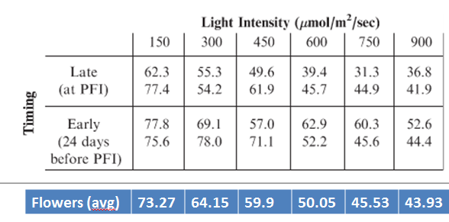
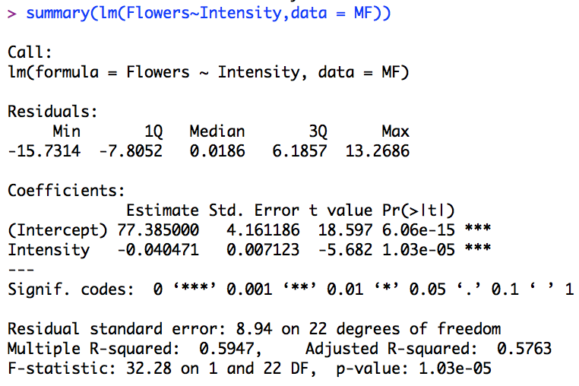
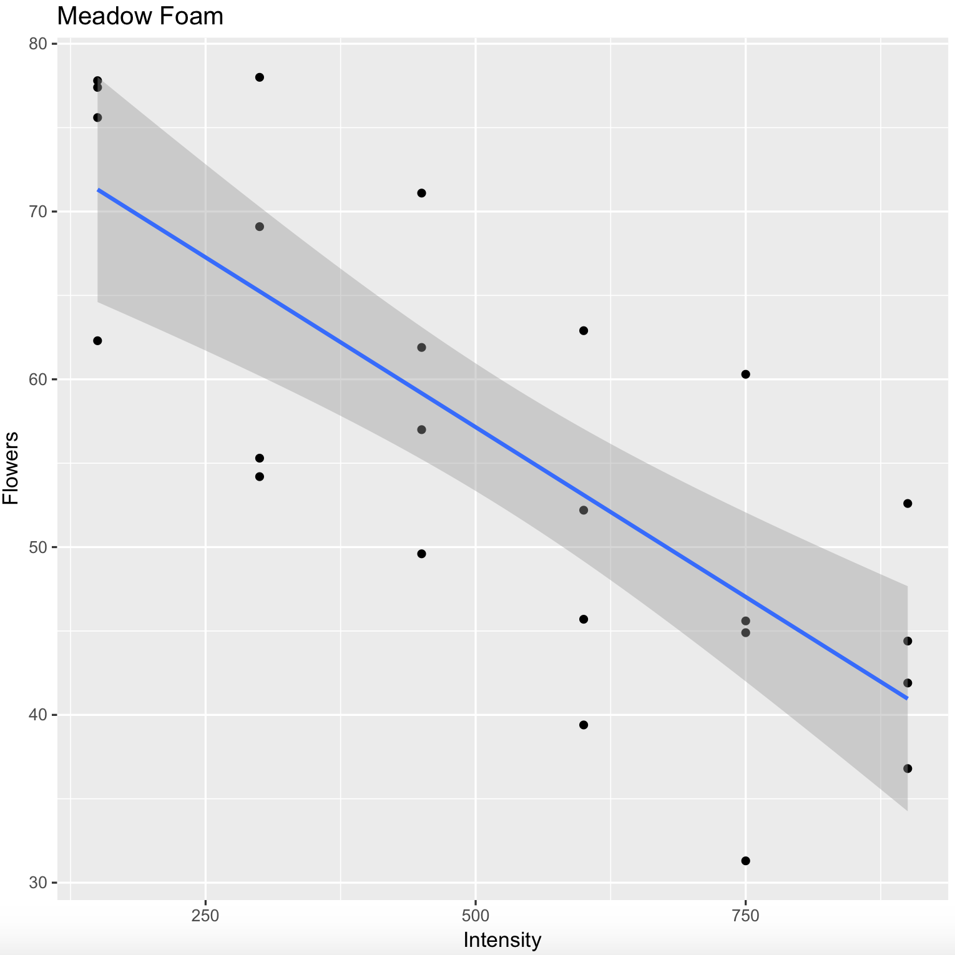

Meadowfoam: Intensity Only
$$\hat{μ}\text{\{}\text{flowers}\text{|}Intensity\text{\} = }β_{0}+β_{1}Intensity$$

Slide 28
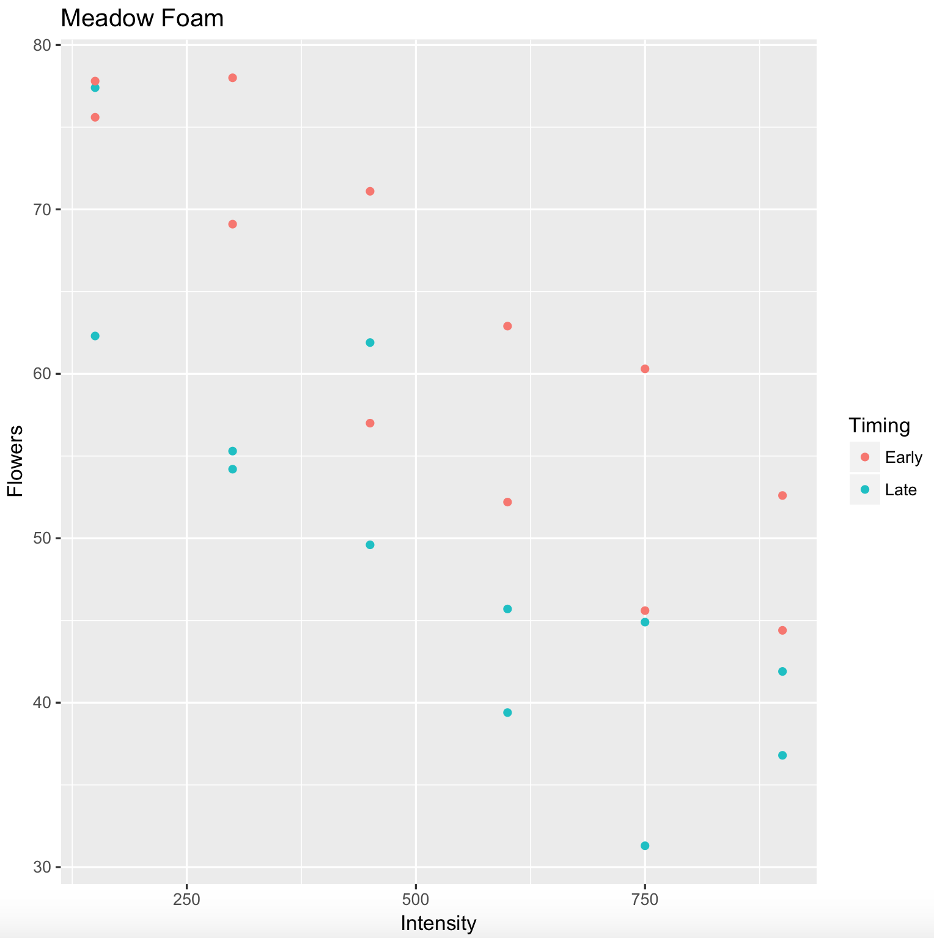
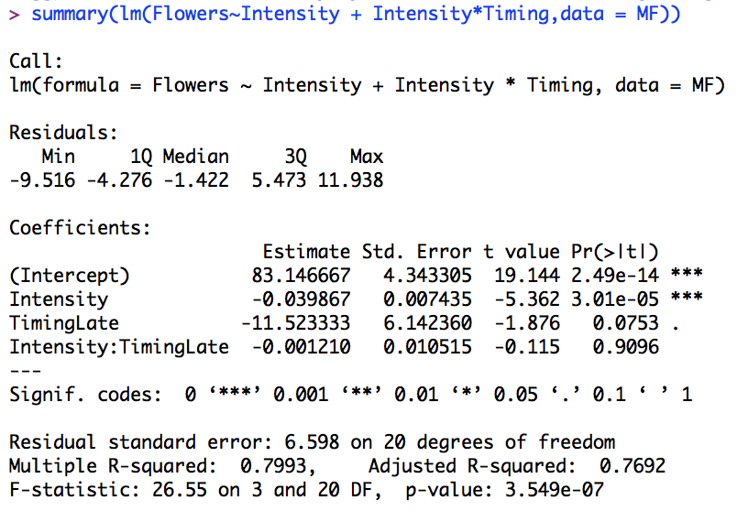
Meadowfoam: Light Intensity and Time
$\hat{μ}\text{\{}\text{flowers}\text{|}\text{Intensity}\text{\} = }β_{0}+β_{1}Intensity+β_{2}time$ $+β_{3}Intensity∗time$

Slide 29
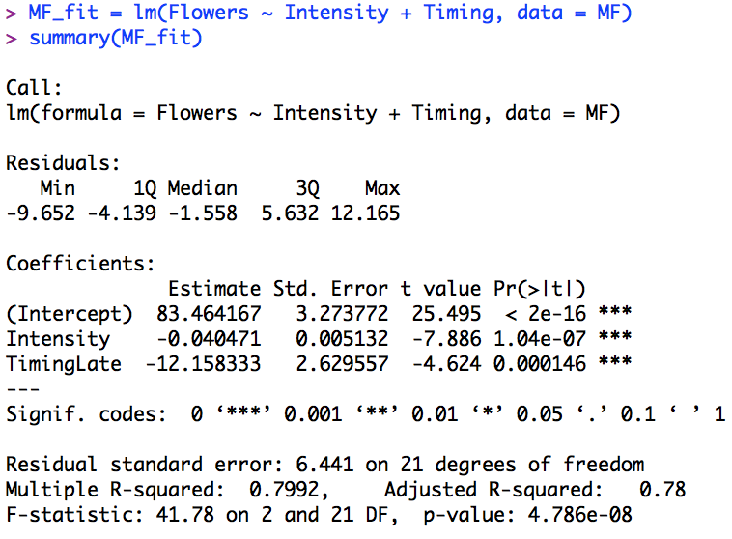
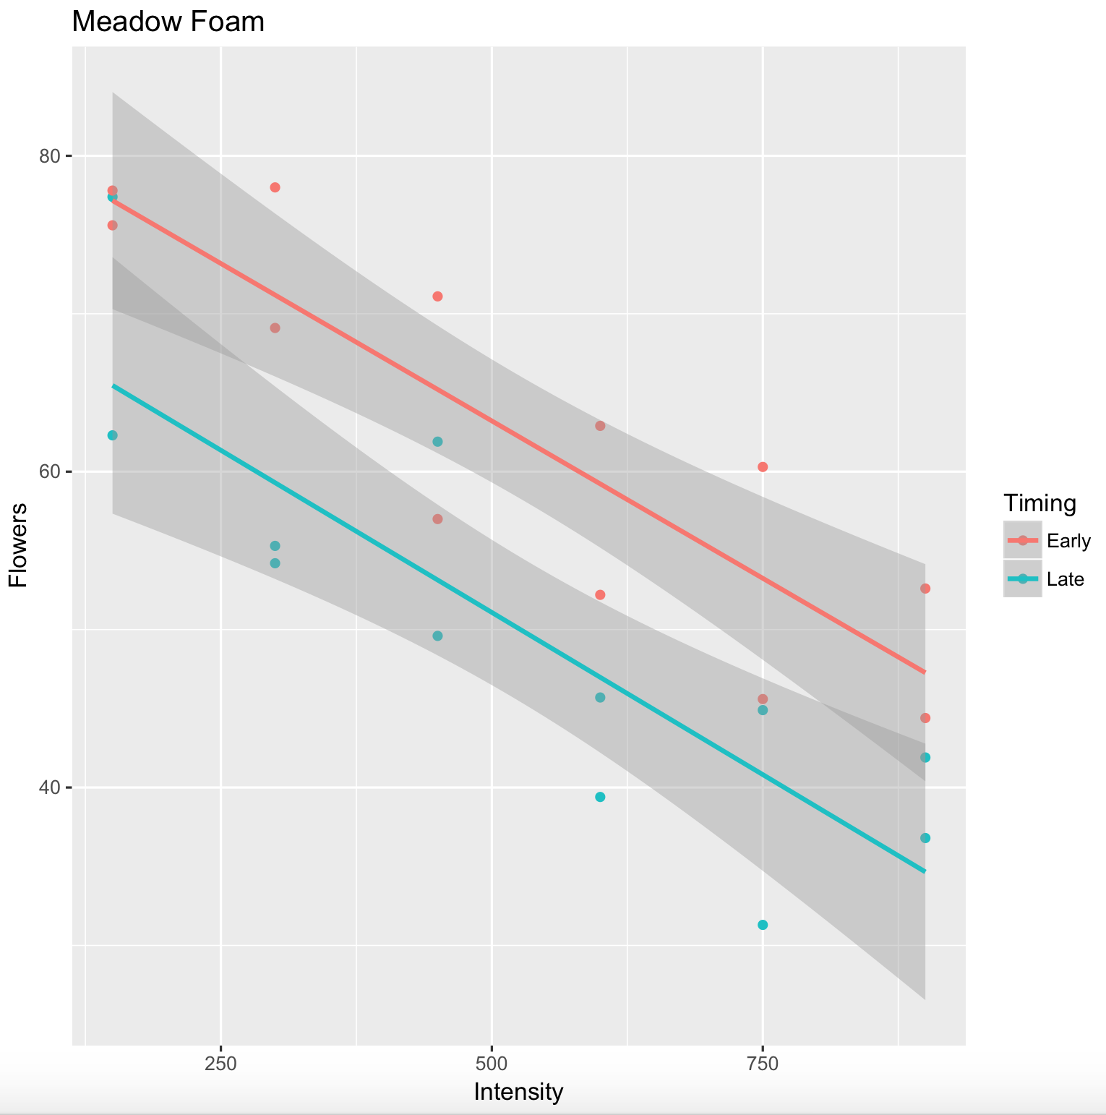


Meadowfoam: Light Intensity and Time
Intercept = 83.46
(Note that chart y-int is off the left end of the chart.
$$\hat{μ}\text{\{}\text{flowers}\text{|}\text{Intensity}\text{\} = }β_{0}+β_{1}Intensity+β_{2}time$$
Intercept = 83.45417 + (- 12.15833)
= 71.3
Slopes = -.04047
$$\hat{μ}\text{\{}\text{flowers}\text{|}\text{light}\text{,}\text{time}\text{ = }\text{Late}\text{\} = }71.3+\left(−.0405\right)Intensity$$
$$\hat{μ}\text{\{}\text{flowers}\text{|}\text{light}\text{,}\text{time}\text{ = }\text{Early}\text{\} = }83.46+\left(−.0405\right)Intensity$$

Slide 30
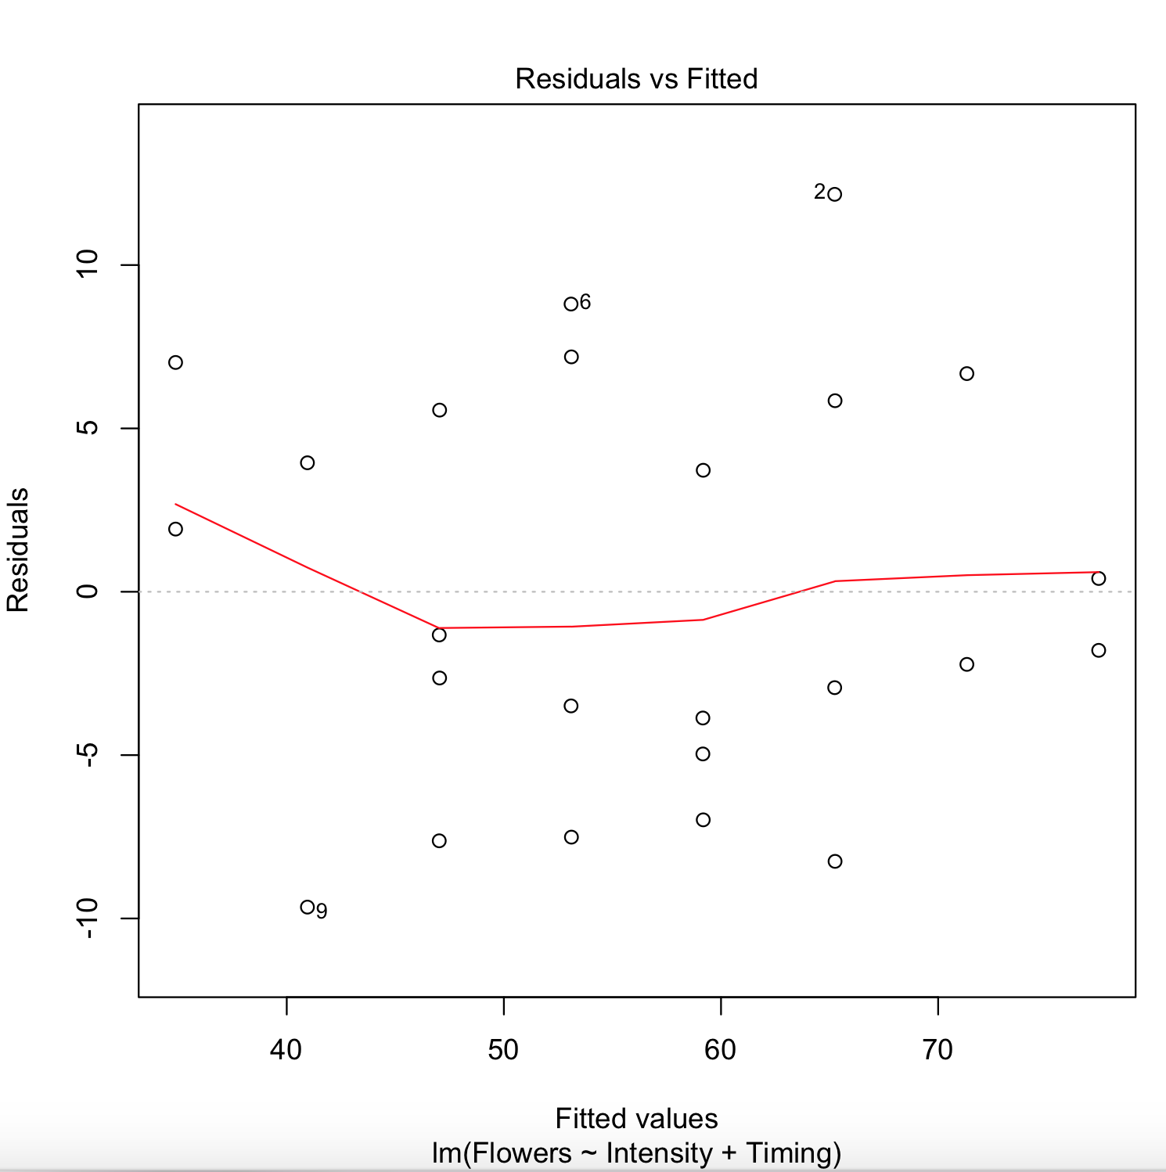
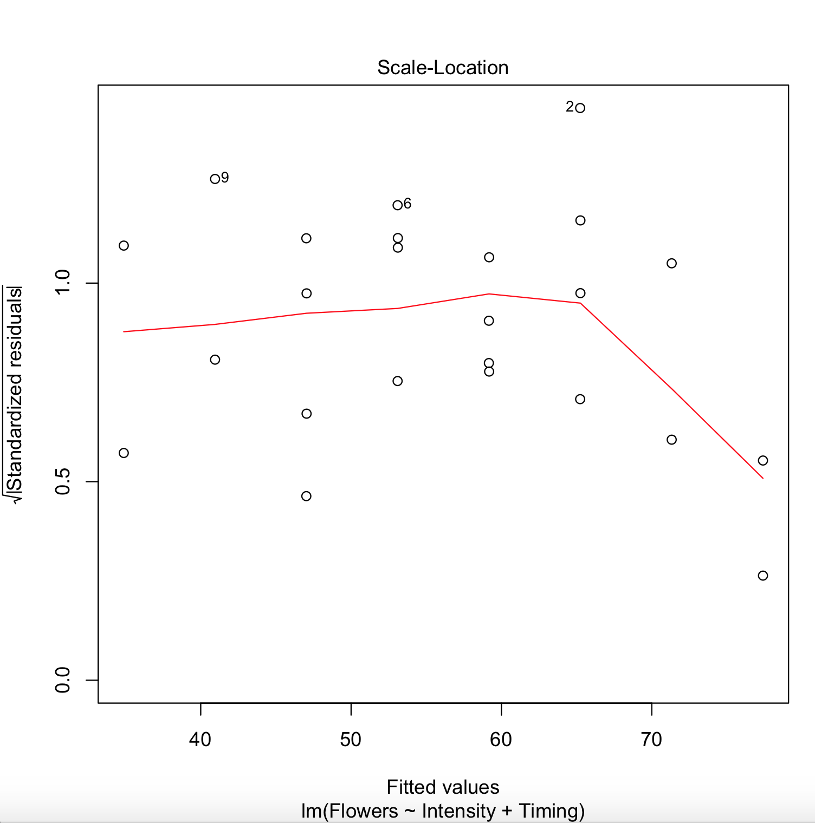
Meadowfoam: Intensity and Timing
$$\hat{μ}\text{\{}\text{flowers}\text{|}Intensity\text{\} = }β_{0}+β_{1}Intensity+β_{2}timing$$
There do not appear to be any extremely influential points. Judging from the scatter plot, qq plot and histogram of the residuals, there is no evidence that the residuals do not follow a normal distribution with constant variance.

Slide 31
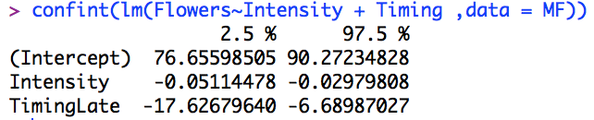
Meadowfoam: Conclusion
Increasing Intensity decreased the mean number of flowers per plant by an estimated 4.0 flowers per plant per 100 nano mol / m2 / sec. (95% confidence interval from 3.0 to 5.1) Beginning the light treatment 24 days before PFI (timing = Early) increased the mean number of flowers per plant by an estimated 12.2 flowers (95% confidence interval from 6.7 to 17.6) We can draw the above causal relationship since the seeds were randomly assigned to each treatment group. Since we have assumed equal slope we can assume this difference is consistent across all intensities (not just at the intensity = 0 (the y-int)).

Slide 32
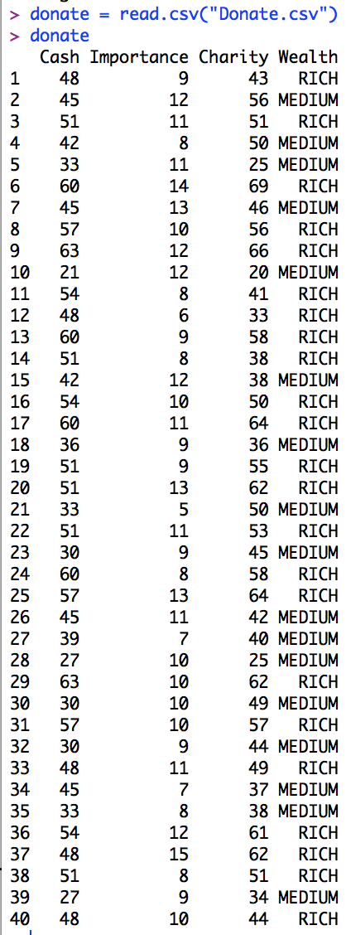
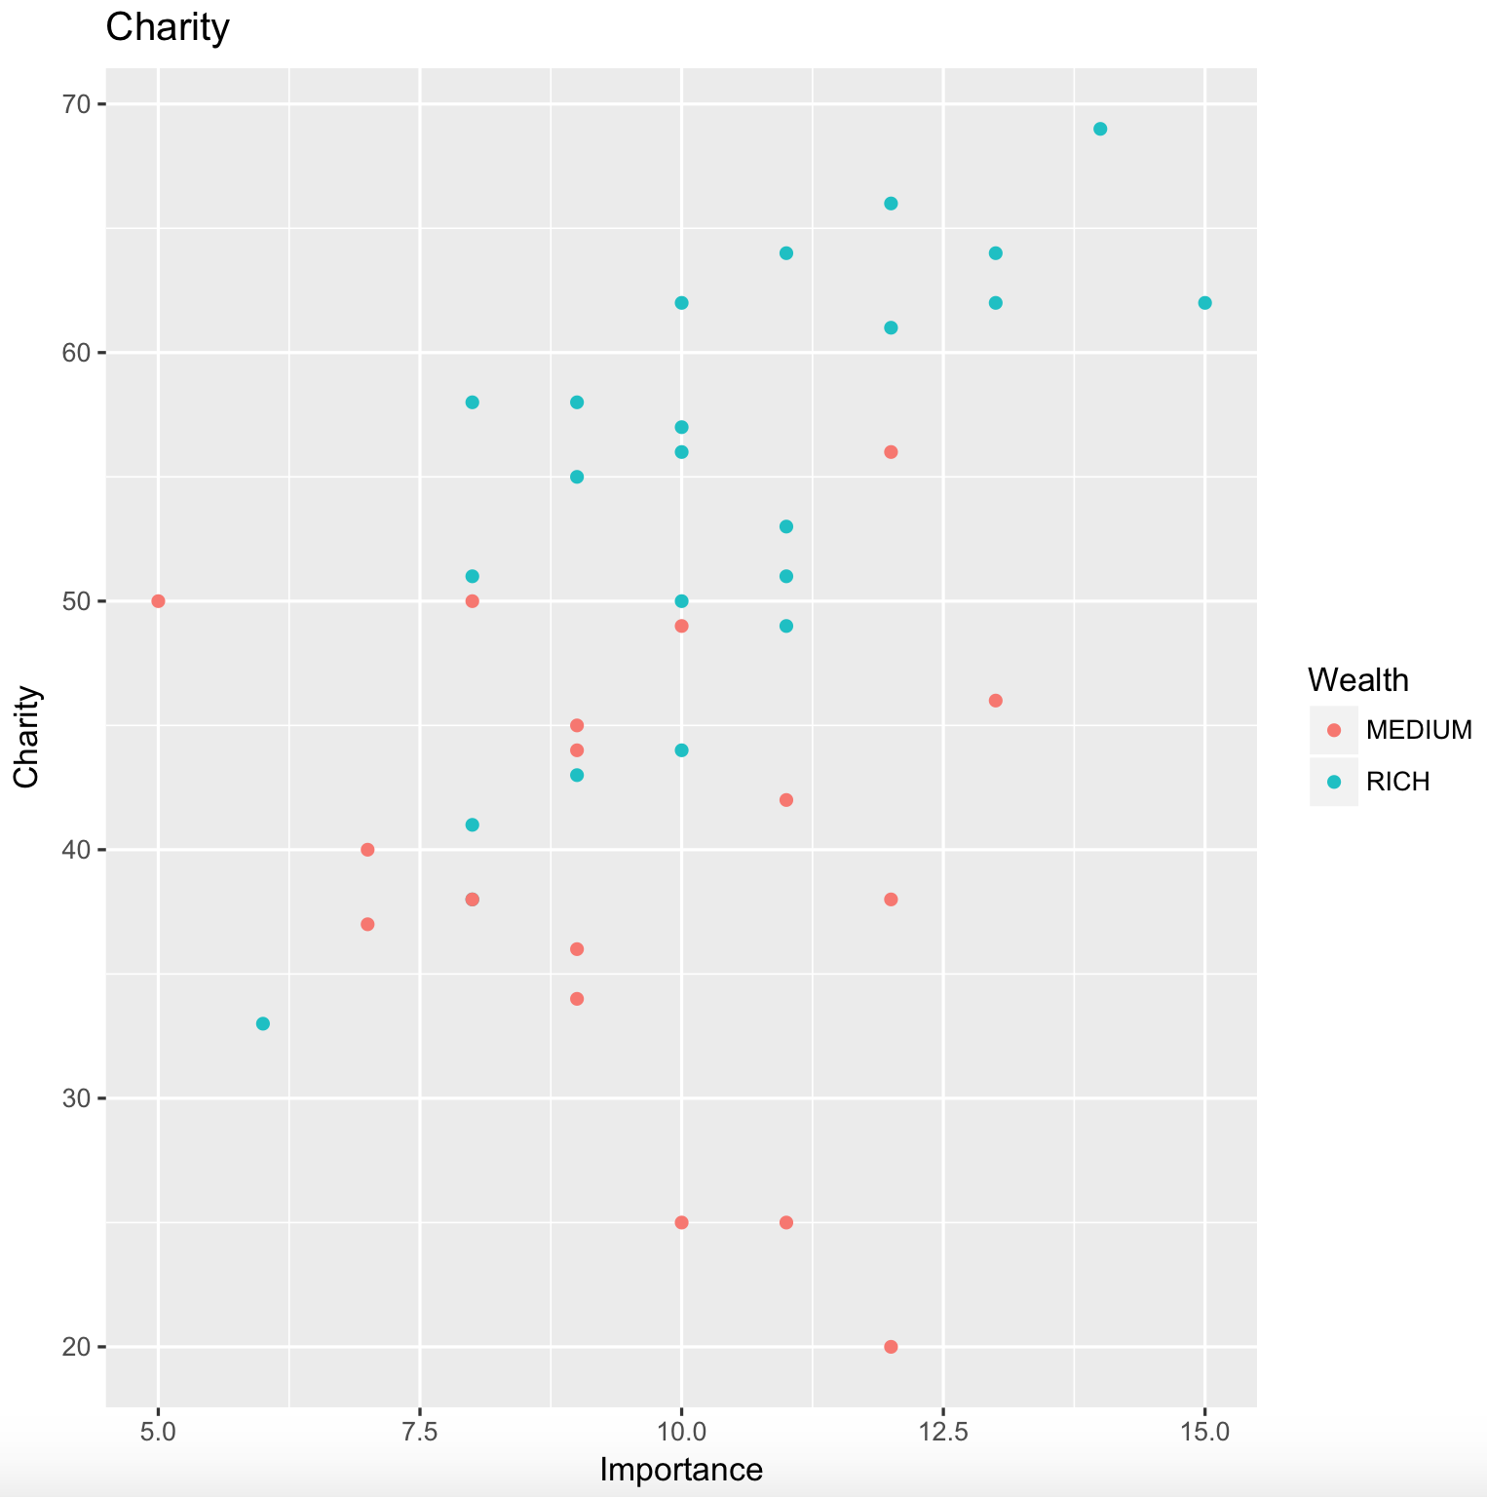
Example Where Interaction Matters
This is a data set that records the amount of cash some one makes (Cash) and the amount of money they give to Charity (Charity) based on the Importance (Importance) each subject attributes to the charity. Wealth is a variable that indicates if the person makes over $45,000 (Rich) or $45,000 or less (Medium).

Slide 33
Example Where Interaction Matters
Construct a multiple linear regression model in which the mean charitable donation depends on (linearly) the importance of the charity and both income groups. Allow for possible different slopes and intercepts.
$$Charity= β_{0}+β_{1}Importance+ β_{2}Wealth+ β_{3}Importance∗Wealth$$

Slide 34
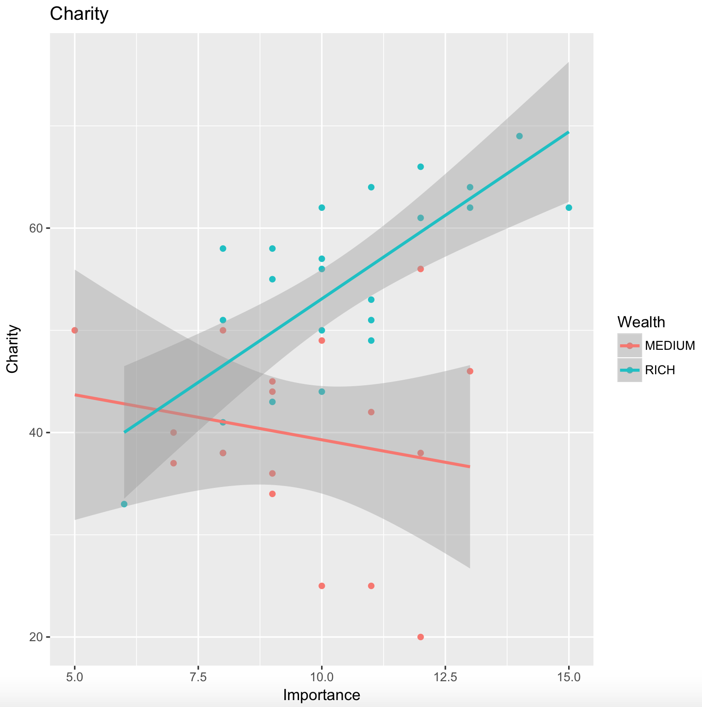
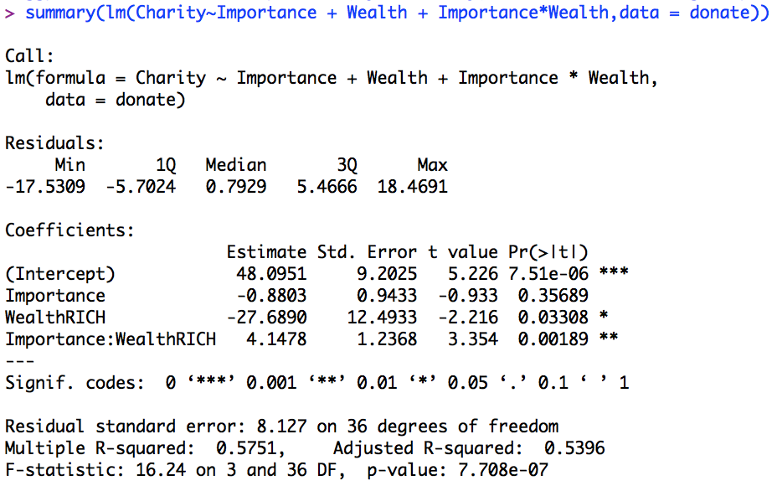
Charity and Perceived Importance: Fit the Model
Pred $Charity= β_{0}+β_{1}Importance+ β_{2}Weatlh+ β_{3}Importance∗Wealth$

Slide 35
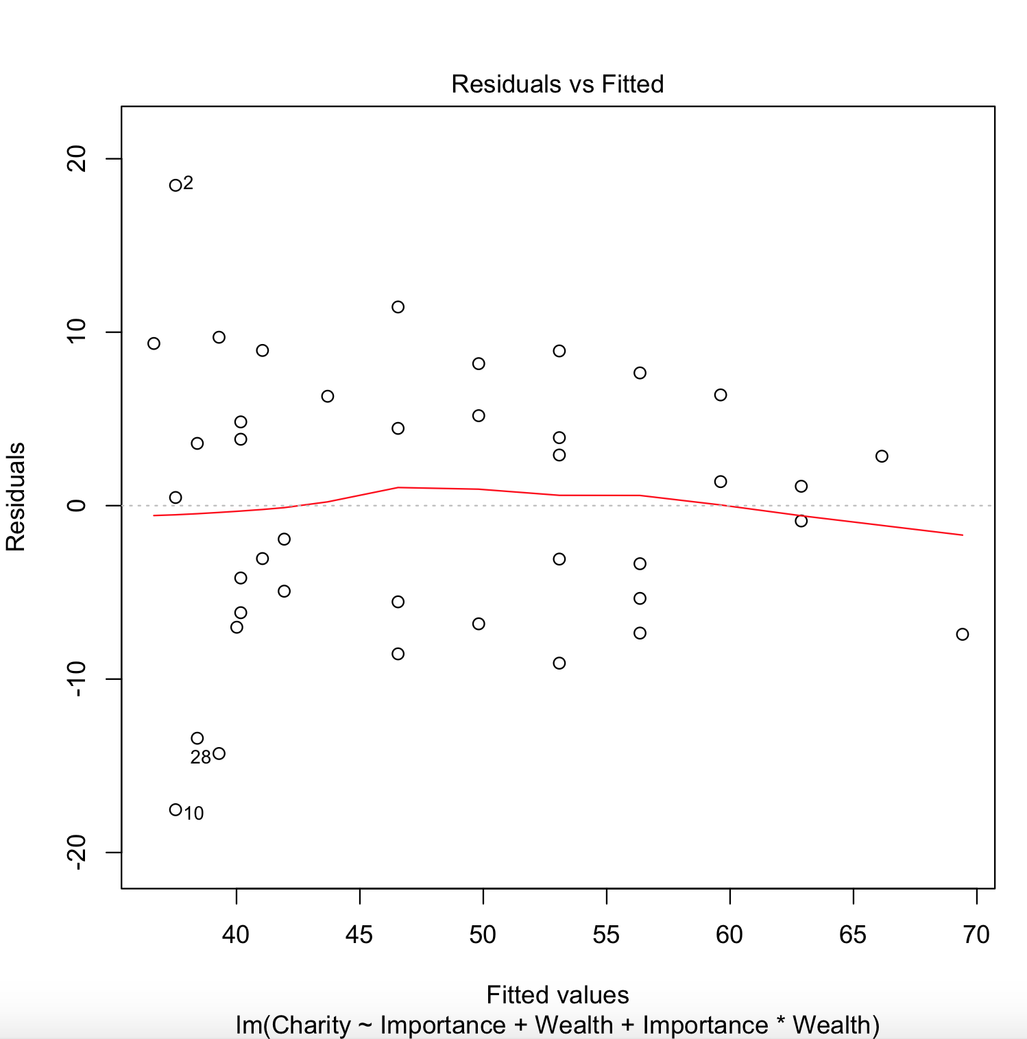
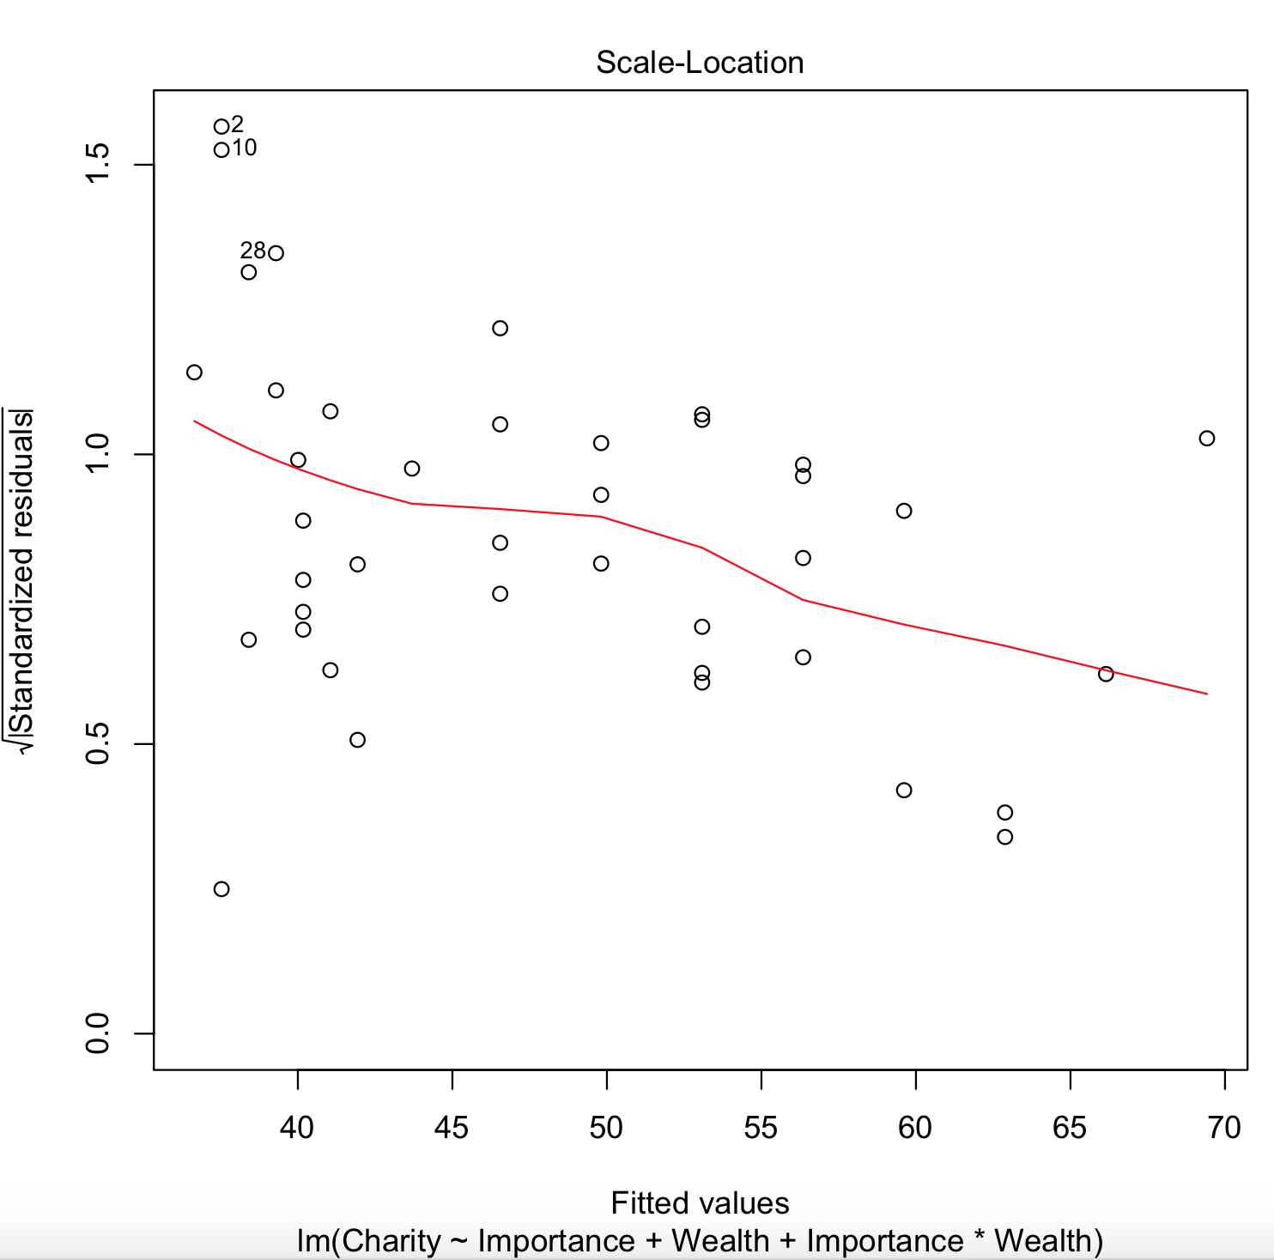
Check the Residuals

Slide 36

Fit the Model
Remember to Include All Terms that are included in an interaction!
$$pred Charity= β_{0}+β_{1}Importance+ β_{2}Wealth+ β_{3}Importance∗Wealth$$
Pred Charity = 48.10 - 27.68 Cash -.8803 Imp + 4.15 Cash *Imp
Pred Charity = (48.10 - 27.68 Cash) + (-.8803 + 4.15 Cash) Imp
Medium: <= $45,000
Rich: > $45,000
Pred Charity = 48.09 + (- 0.88) Importance
Pred Charity = 20.41 + 3.27Importance

Slide 37
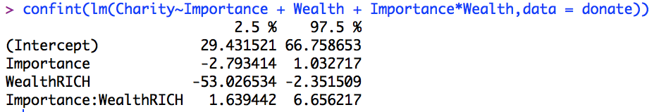
Conclusion
Medium: <= $45,000
Rich: > $45,000
Pred Charity = 48.09 + (- 0.88) Importance
Pred Charity = 20.41 + 3.27 Importance
For Wealthy donors, it is estimated that for every 1 additional point increase in importance, the amount they will donate to charity increases $3.27. For donors of Medium wealth, there is not significant evidence to suggest that the level of importance is a factor in the amount they will donate (p-value = .3569 ).

Slide 38
Question 1

Slide 39
HSB2 Example
We would like to create a model with a categorical variable for socioeconomic status (SES) in order to test if there is a difference in mean science score for changes between SES = 3 to SES = 1 and SES = 3 to SES =2, taking the math score into account. (Assume math is associated with the science score in the same way for each SES. ) Can we quantify these amounts? That is, by how much can we expect the science score to increase or decrease with respect to SES = 3 (make SES = 3 the reference level). Be sure and write out the model statement and check assumptions!
Now fit a model with flexible slopes and check the assumption above. Is there reason / evidence to believe that the slopes are different between any two SES levels?
Finally, we want to know if and how much the math score is related to the science score after controlling for the reading score. Be sure and write out the model statement and check assumptions!

Slide 40
HSB2 Example
We would like to create a model with a categorical variable for socioeconomic status (SES) in order to test if there is a difference in mean science score for changes between SES = 3 to SES = 1 and SES = 3 to SES =2, taking the math score into account. (Assume math is associated with the science score in the same way for each SES. ) Can we quantify these amounts? That is, by how much can we expect the science score to increase or decrease with respect to SES = 3 (make SES = 3 the reference level). Be sure and write out the model statement and check assumptions!

Slide 41
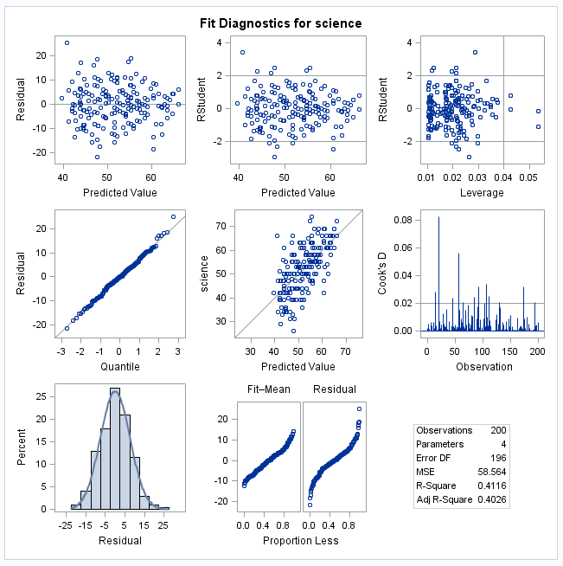

Influential Points and Assumptions!!!
$$\hat{μ}\text{\{}\text{Science} \text{Score}\text{|}\text{SES}\text{, }\text{Math}\text{\} =}{ β}_{0}+β_{1}SES1+β_{2}SES2+β_{3}Math$$
There do not appear to be any extremely influential points.
Judging from the scatter plot, q-q plot, and histogram of the residuals, there is not sufficient evidence that the residuals do not follow a normal distribution with constant variance.
Linearity – There is no trend in the residuals which is consistent with a linear relationship between the mean of y and x.
Normality – the random cloud around zero in the residual plot is consistent with the normality assumption being met. We don’t see any extreme outlying observations in one direction more that than the other.
Constant Standard Deviation – there is not a fanning pattern in the residuals that would be consistent with non equal standard deviation. The residuals are consistent with equal standard deviation.
We assume here that the observations are independent, although we do this with caution as they are known to be clustered by school.

Slide 42
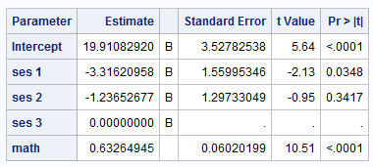
Question 1
$$\hat{μ}\text{\{}\text{Science} \text{Score}\text{|}\text{SES}\text{, }\text{Math}\text{\} =}{ β}_{0}+β_{1}SES1+β_{2}SES2+β_{3}Math$$
SES value | SES1 | SES2
1 | 1 | 0
2 | 0 | 1
3 | 0 | 0
SES = 3 precisely when SES1 = 0 and SES2 = 0
SES = 2 precisely when SES1 = 0 and SES2 = 1
SES = 1 precisely when SES1 = 1 and SES2 = 0
$$\hat{μ}\text{\{}\text{Science} \text{Score}\text{|}\text{SES}\text{ , }\text{Math}\text{\}}=19.91−3.316∗SES1 −1.236 SES2+ .633 Math$$
0
0
$\hat{μ}\text{\{}\text{Science} \text{Score}\text{|}\text{SES}\text{ = 3}\text{, }\text{Math}\text{\} }$= 19.91 – 3.316*0- 1.236*0+ .633 * Math
$\hat{μ}\text{\{}\text{Science} \text{Score}\text{|}\text{SES}\text{ = 3}\text{, }\text{Math}\text{\} }$= 19.91 + .633 * Math
0
$\hat{μ}\text{\{}\text{Science} \text{Score}\text{|}\text{SES}\text{ = 2}\text{, }\text{Math}\text{\} }$= 19.91 –3.316*0 - 1.236*1 + .633*Math
$\hat{μ}\text{\{}\text{Science} \text{Score}\text{|}\text{SES}\text{ = 2}\text{, }\text{Math}\text{\} }$= (19.91 –1.236) + .633*Math
$\hat{μ}\text{\{}\text{Science} \text{Score}\text{|}\text{SES}\text{ = 2}\text{, }\text{Math}\text{\} }$= 18.67 + .633*Math
0
$$\hat{μ}\text{\{}\text{Science} \text{Score}\text{|}\text{SES}\text{ = 1}\text{, }\text{Math}\text{\}= 19.91 – 3.316∗1− 1.236∗0+ .633 ∗ }\text{Math}$$
$$\hat{μ}\text{\{}\text{Science} \text{Score}\text{|}\text{SES}\text{ = 1}\text{, }\text{Math}\text{\}= (19.91 – 3.316)+ .633 ∗ }\text{Math}$$
$$\hat{μ}\text{\{}\text{Science} \text{Score}\text{|}\text{SES}\text{ = 1}\text{, }\text{Math}\text{\}= 16.59+ .633 ∗ }\text{Math}$$

Slide 43
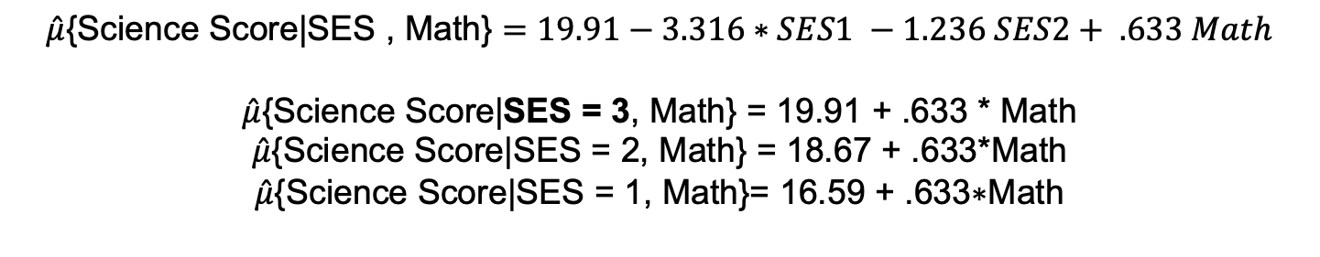
Question 1
$$\hat{μ}\text{\{}\text{Science} \text{Score}\text{|}\text{SES}\text{, }\text{Math}\text{\} =}{ β}_{0}+β_{1}SES1+β_{2}SES2+β_{3}Math$$
SES value | SES1 | SES2
1 | 1 | 0
2 | 0 | 1
3 | 0 | 0
$$\hat{μ}\text{\{}\text{Science} \text{Score}\text{|}\text{SES}\text{ , }\text{Math}\text{\}}=19.91−3.316∗SES1 −1.236 SES2+ .633 Math$$
$\hat{μ}\text{\{}\text{Science} \text{Score}\text{|}\text{SES}\text{ = 3}\text{, }\text{Math}\text{\} }$= 19.91 + .633 * Math
$\hat{μ}\text{\{}\text{Science} \text{Score}\text{|}\text{SES}\text{ = 2, }\text{Math}\text{\} }$= 18.67 + .633*Math
$$\hat{μ}\text{\{}\text{Science} \text{Score}\text{|}\text{SES}\text{ = 1, }\text{Math}\text{\}= 16.59 + .633∗}\text{Math}$$
95% CI: t_{.975, 200-4}=1.97
3.316+- 1.97*1.56
=3.316+-3.07
=(.24, 6.4)
A change from SES = 3 to SES =2 does not appear to significantly influence the mean science score although a change from SES = 1 to SES = 3 appears to be significant in estimating the mean science score for a given math score. The best estimate is that a change from SES = 3 to SES = 1 is associated with a 3.316 point decrease in the mean science score. A 95% confidence interval for this decrease is (.24, 6.4) points. In addition, since the slopes are assumed to be identical, this change is assumed to be constant across all math scores. This is an observational study thus only associations can be made. The data could be rerun by grouping SES=3 and SES=2 together, but we will leave it as is here.

Slide 44
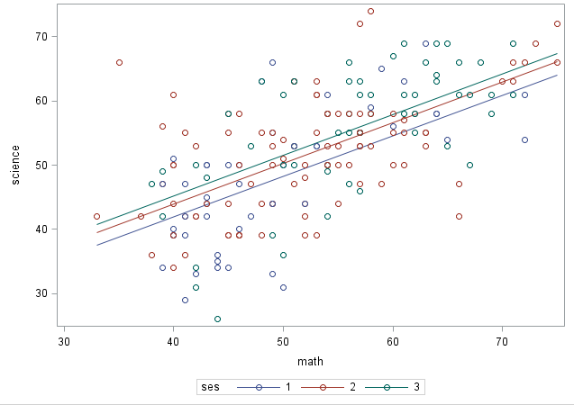
Question 1: That is, by how much can we expect the science score to increase or decrease with respect to SES = 3 (make SES = 3 the reference level).

Slide 45
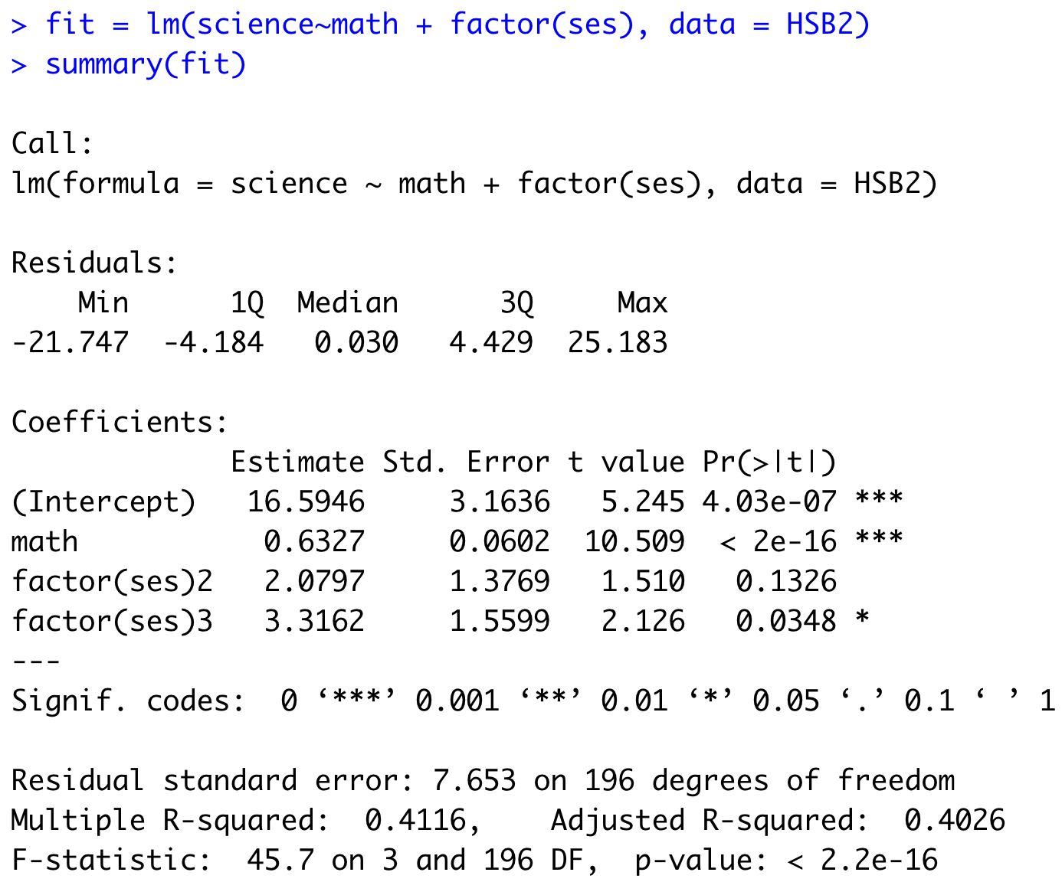
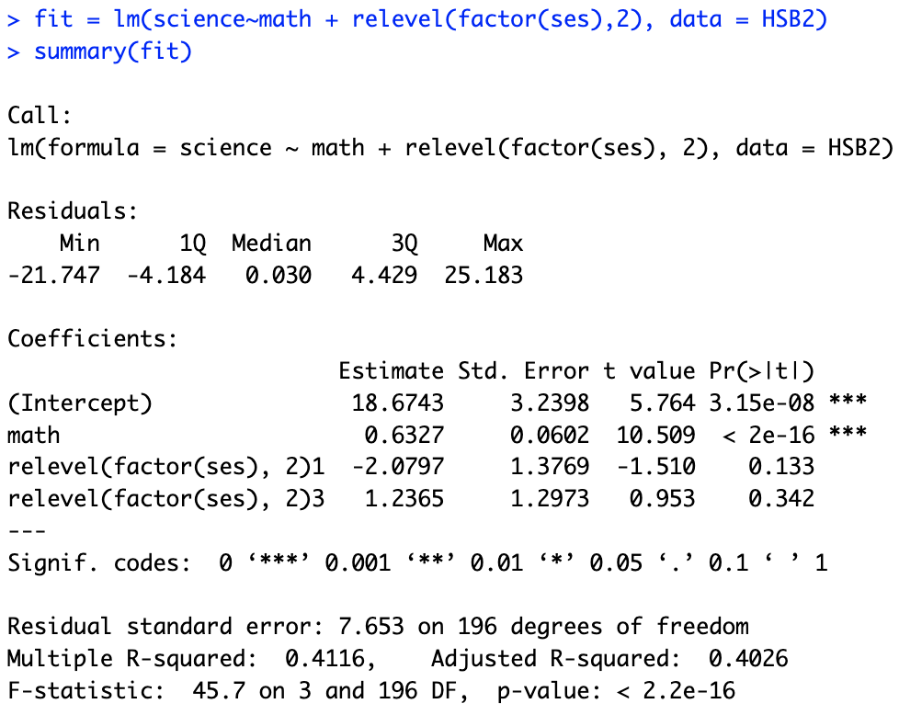

R Solution: Changing the Reference Level
Ref = 1
Ref = 2
Ref = 3

Slide 46
End Question 1

Slide 47
Question 2

Slide 48
HSB2 Example
We would like to create a model with a categorical variable for socioeconomic status (SES) in order to test if there is a difference in mean science score for changes between SES = 3 to SES = 1 and SES = 3 to SES =2, taking the math score into account. (Assume math is associated with the science score in the same way for each SES. ) Can we quantify these amounts? That is, by how much can we expect the science score to increase or decrease with respect to SES = 3 (make SES = 3 the reference level). Be sure and write out the model statement and check assumptions!
Now fit a model with flexible slopes and check the assumption above. Is there reason / evidence to believe that the slopes are different between any two SES levels?

Slide 49
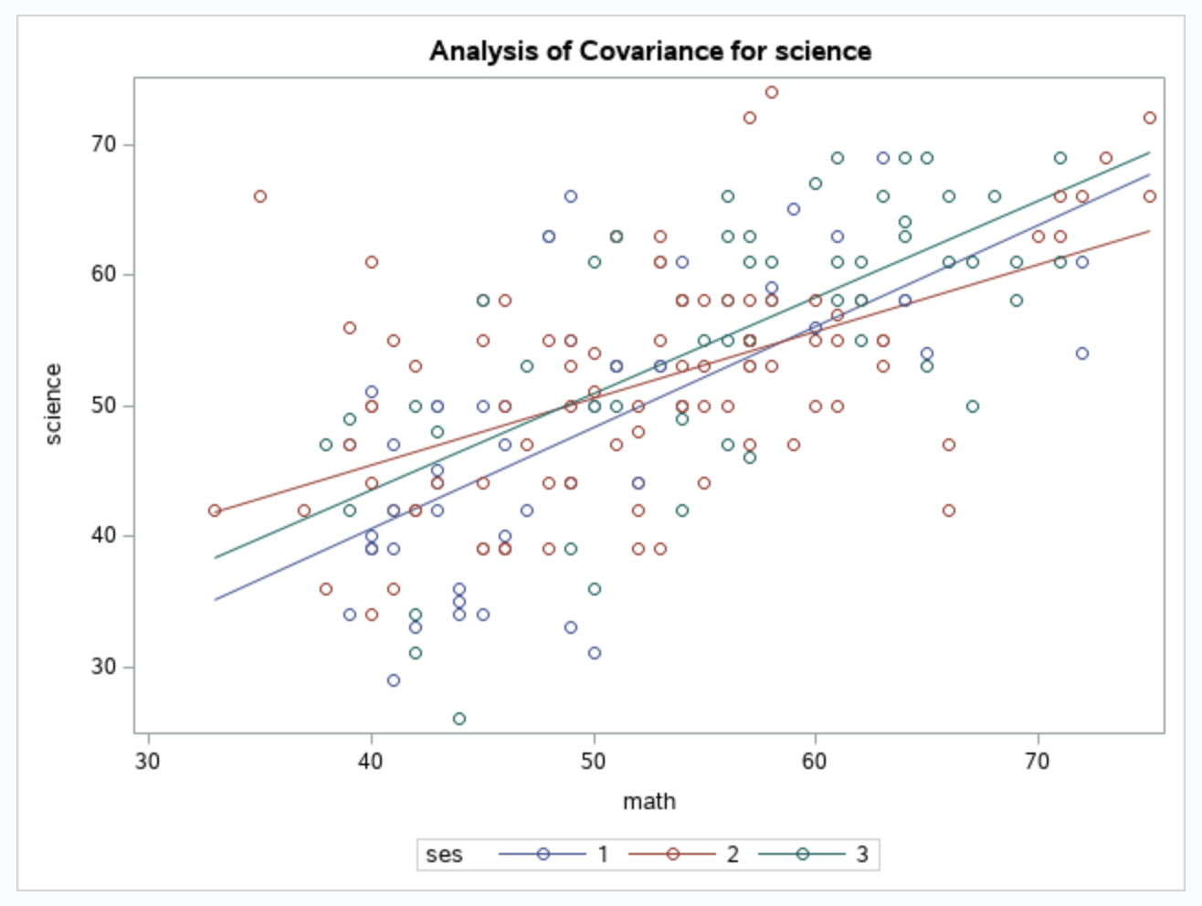
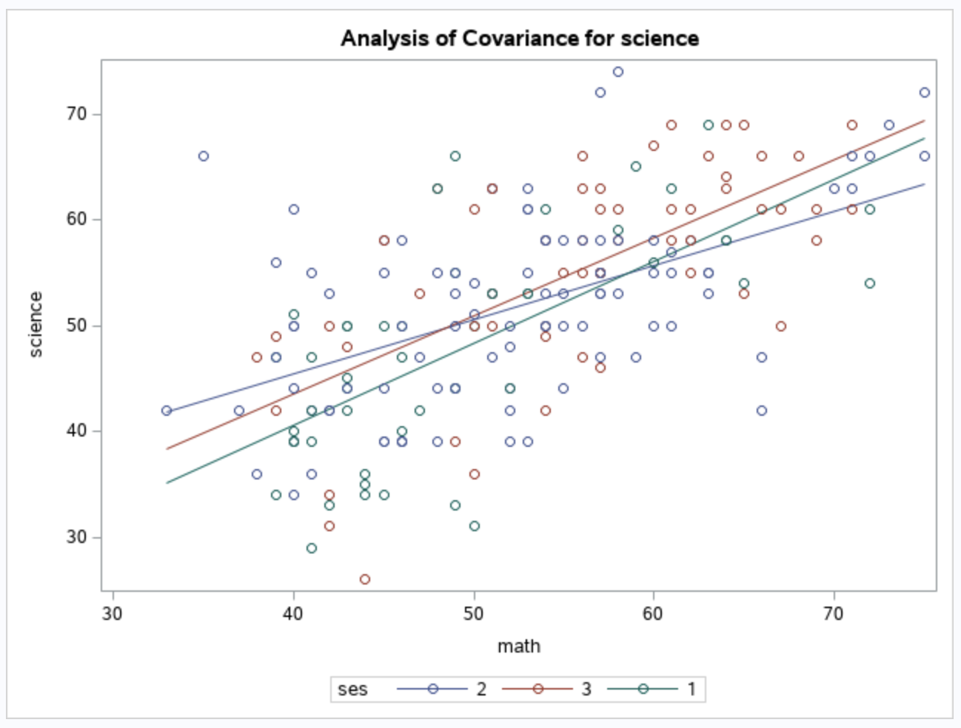
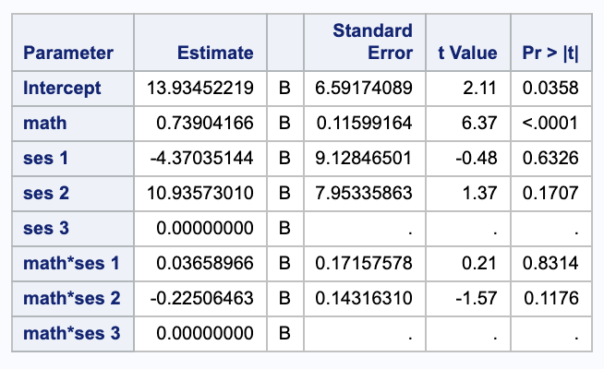
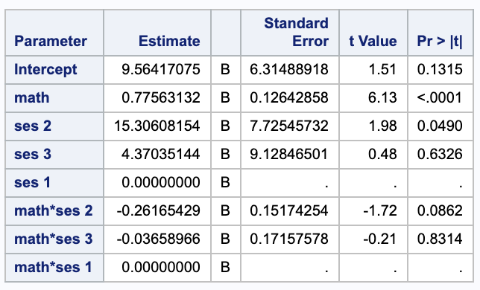
Comparing Slopes Between SES Levels
proc glm data = HSB2;
class SES;
model science = math | SES / solution;
run;
proc glm data = HSB2;
class SES (ref = "1");
model science = math | SES / solution;
run;
There is not enough evidence to suggest that the relationship between science and math is different between any of the SES levels.

Slide 50
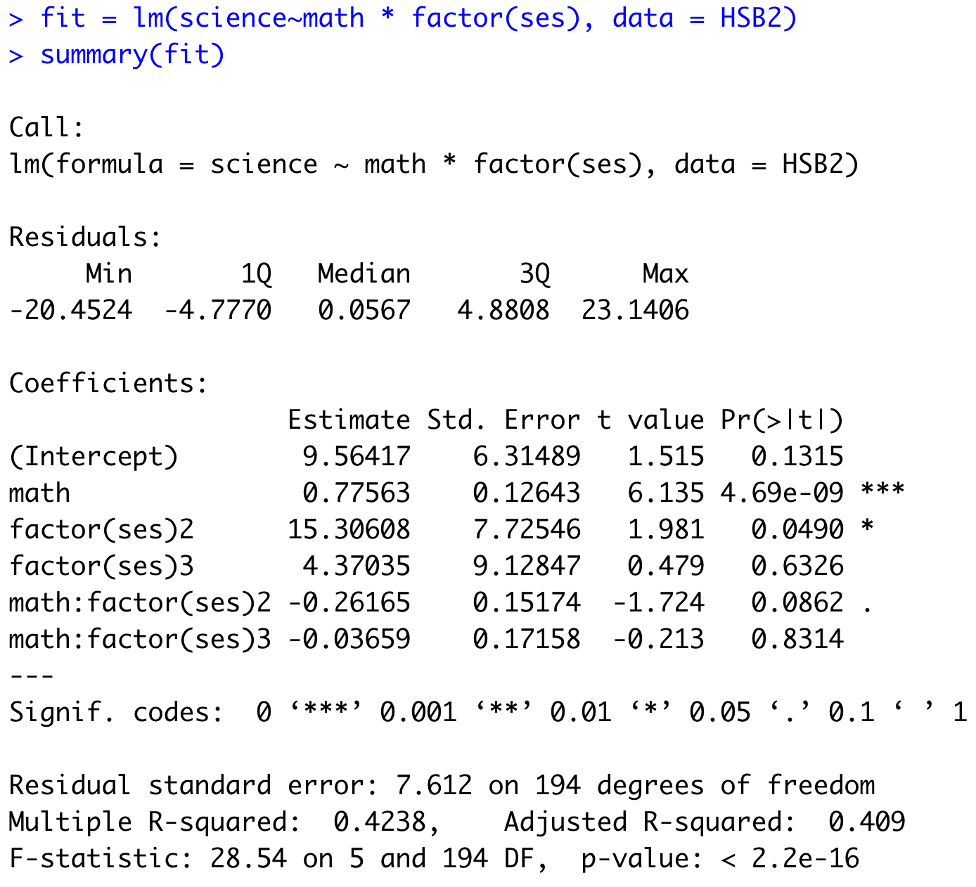
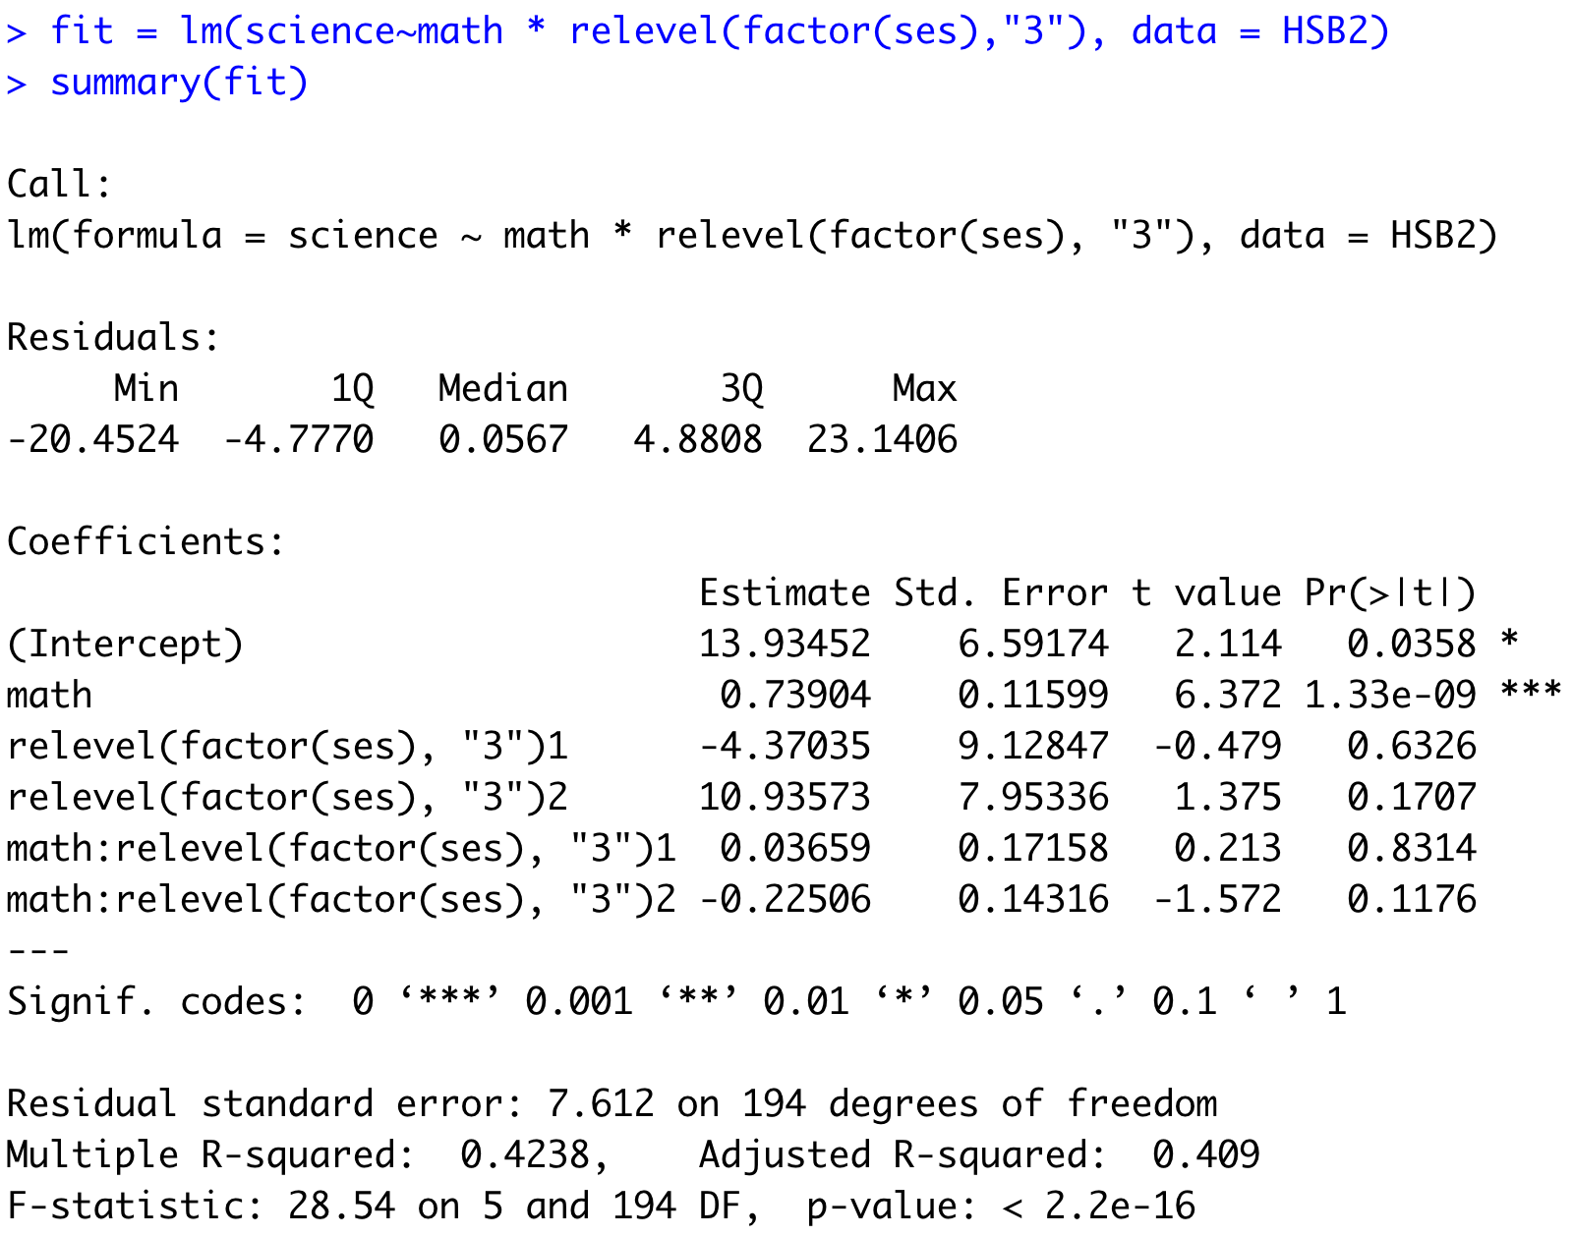
R Solution: Testing for Significant Interaction (Different Slopes)

Slide 51
End Question 2

Slide 52


logmass
logmetab
Loglife

Slide 53
Question 3

Slide 54
HSB2 Example
We would like to create a model with a categorical variable for socioeconomic status (SES) in order to test if there is a difference in mean science score for changes between SES = 3 to SES = 1 and SES = 3 to SES =2, taking the math score into account. (Assume math is associated with the science score in the same way for each SES. ) Can we quantify these amounts? That is, by how much can we expect the science score to increase or decrease with respect to SES = 3 (make SES = 3 the reference level). Be sure and write out the model statement and check assumptions!
Now fit a model with flexible slopes and check the assumption above. Is there reason / evidence to believe that the slopes are different between any two SES levels?
Finally, we want to know if and how much the math score is related to the science score after controlling for the reading score. Be sure and write out the model statement and check assumptions!

Slide 55


Question 3: Influential Points and Assumptions!!!
$$\hat{μ}\text{\{}\text{Science} \text{Score}\text{|}\text{Math}\text{, }\text{Read}\text{\} =}{ β}_{0}+β_{1}Math+β_{2}Read$$
There does appear to be one potential influential point. We should take a closer look at this observation.
Judging from the scatter plot, q-q plot and histogram of the residuals, there is no evidence that the residuals do not follow a normal distribution with constant variance.
We assume here that the observations are independent although we do this with caution as they are known to be clustered by school.

Slide 56



Question 3:
$$\hat{μ}\text{\{}\text{Science} \text{Score}\text{|}\text{Math}\text{\} =}{ β}_{0}+β_{1}Math$$
$$\hat{μ}\text{\{}\text{Science} \text{Score}\text{|}\text{Math}\text{, }\text{Read}\text{\} =}{ β}_{0}+β_{1}Math+β_{2}Read$$
There is overwhelming evidence to suggest that the math score is associated with the mean science score even after the reading score has been accounted for. It is estimated, holding the reading score constant, a 1 point increase in the math score is associated with a .4 point increase in the mean science score. This is an observational study thus only associations can be made.

Slide 57
End Question 3

Slide 58
Question 4: Takeaways!
Please provide at least 4 takeaways from this section and any questions that you may have. These questions will help design the live session for this unit.
This question will be the last question of every For Live Session Assignment. The idea is that this deck will serve as a document that you can reference in the future to remember what was covered in this section. For instance, this may come in handy for the Capstone and will hopefully become useful in your career. Most immediately, it may become handy as a quick reference for your Midterm and Final! Some students find it very useful and spend a few slides summarizing the async material while others learn different ways and only had the minimum 4 takeaways. Either is fine and will earn you full credit for this question.

Slide 59
Question 5: Questions!
Please provide any question or topics of discussion that came up in this Unit! These will help help us optimize our live session for maximum learning and takeaways!
This question will be the last question of every For Live Session Assignment. The idea is that this deck will serve as a document that you can reference in the future to remember what was covered in this section. For instance, this may come in handy for the Capstone and will hopefully become useful in your career. Most immediately, it may become handy as a quick reference for your Midterm and Final! Some students find it very useful and spend a few slides summarizing the asynch material while others learn different ways and only had the minimum 4 takeaways. Either is fine and will earn you full credit for this question.

Slide 60
End For Live Session Assignment Unit 12!

